Slide 1
Building a QM-Focused Framework for Online Programs: A Collaborative Model for Scalable Success
Lauran Guerra, Senior Instructional Designer
Cynthia Farias, Education Technologist

Slide 2
Objectives
Identify key components of a scalable quality assurance framework for online program development.
Apply strategies for supporting faculty through structured training and milestone check-ins.
Evaluate lessons learned from a pilot implementation to inform their own program design.

Slide 3
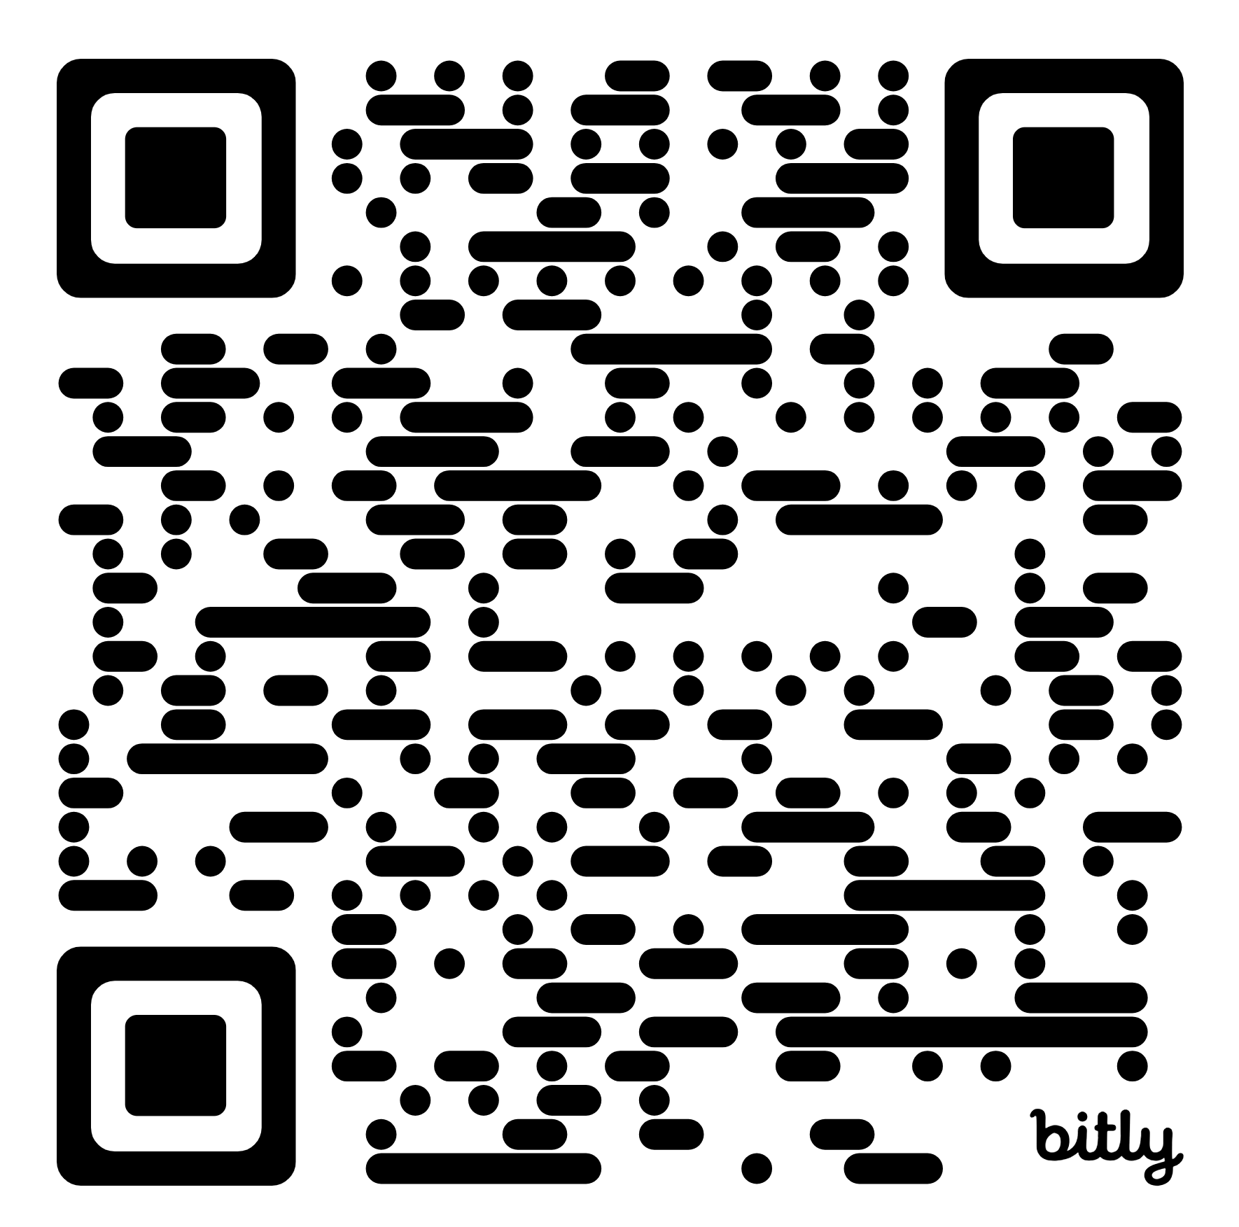
Downloading the Toolkit
Scan above or go to: https://bit.ly/4hnZB6O

Slide 4

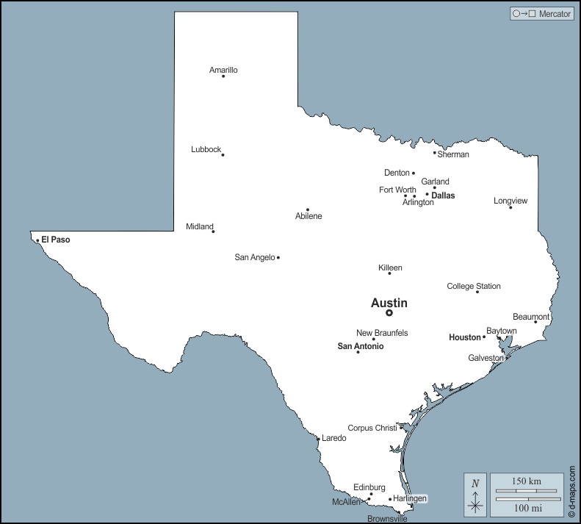
Introductions and Institutional Context

Slide 5


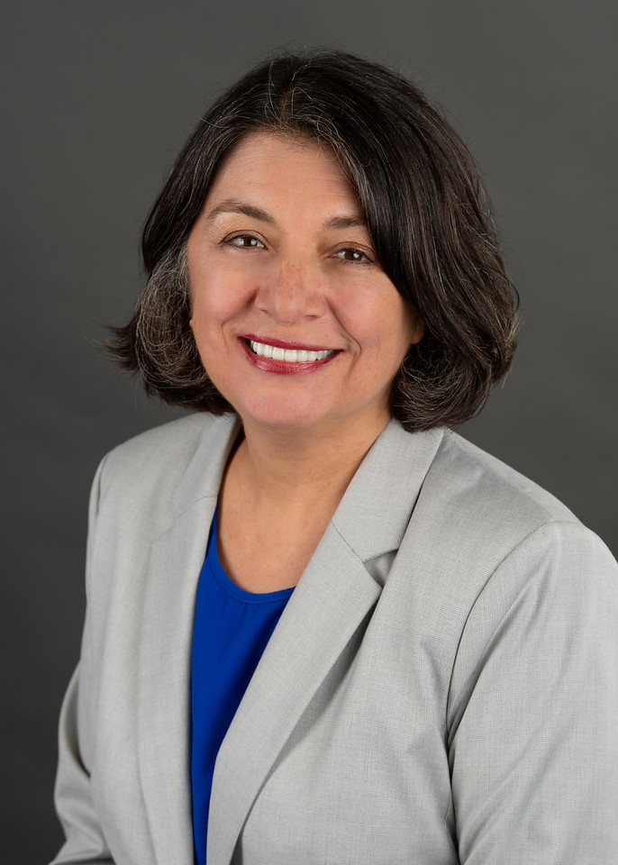
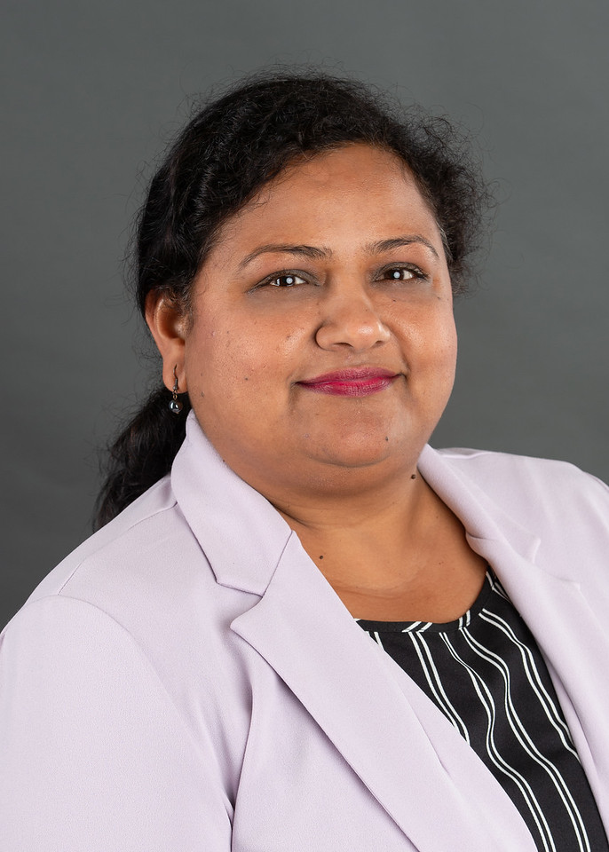
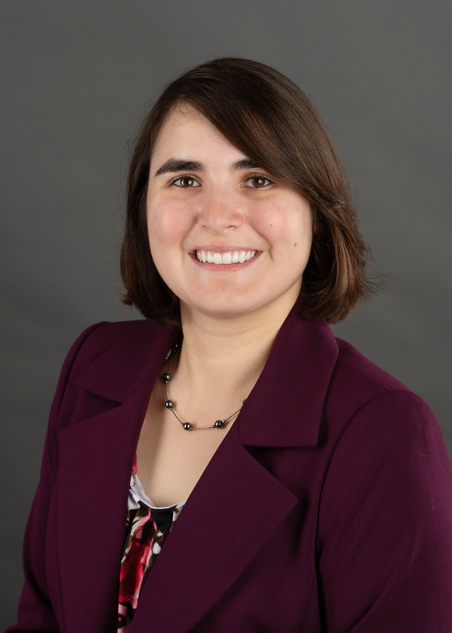
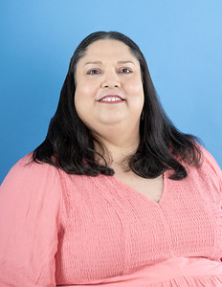

Slide 6
How were we supporting the design and development of online programs?
Faculty develop course
ID’s Review Course*
Faculty may or may not apply recs
*An In-house rubric based on best practices was used at this time.

Slide 7
We have been a QM subscriber for years!
No concerted effort to send faculty through APPQMR or to develop courses based on the QM rubric.
No courses undergoing QM review.
What changed?
Leadership!

Slide 8
How are we supporting the design and development of online programs NOW?
Quality Assurance Program - Basic Process
1. In-take
2. Proposal
3. APPQMR
4. Kickoff
5. Course Development and ID Review*
6. Recommendation for stipend award
Bonus: QM External Review

Slide 9
In-Take Process
Quality Assurance Program - Basic Process
1. In-take
2. Proposal
3. APPQMR
4. Kickoff
5. Course Development and ID Review*
6. Recommendation for stipend award
Bonus: QM External Review
What? When? How? Who?

Slide 10
Proposal stage
Quality Assurance Program - Basic Process
1. In-take
2. Proposal
3. APPQMR
4. Kickoff
5. Course Development and ID Review*
6. Recommendation for stipend award
Bonus: QM External Review
Proposal created/approved.

Slide 11
APPQMR Stage
Quality Assurance Program - Basic Process
1. In-take
2. Proposal
3. APPQMR
4. Kickoff
5. Course Development and ID Review*
6. Recommendation for stipend award
Bonus: QM External Review
Faculty complete APPQMR.

Slide 12
Kickoff Faculty Workshop
Quality Assurance Program - Basic Process
1. In-take
2. Proposal
3. APPQMR
4. Kickoff
5. Course Development and ID Review*
6. Recommendation for stipend award
Bonus: QM External Review
All-day, in-house Workshop.

Slide 13
Course Mapped, Built, and Reviewed
Quality Assurance Program - Basic Process
1. In-take
2. Proposal
3. APPQMR
4. Kickoff
5. Course Development and ID Review*
6. Recommendation for stipend award
Bonus: QM External Review
Comprehensive Template, Course Map, and Alignment-focused Review.

Slide 14
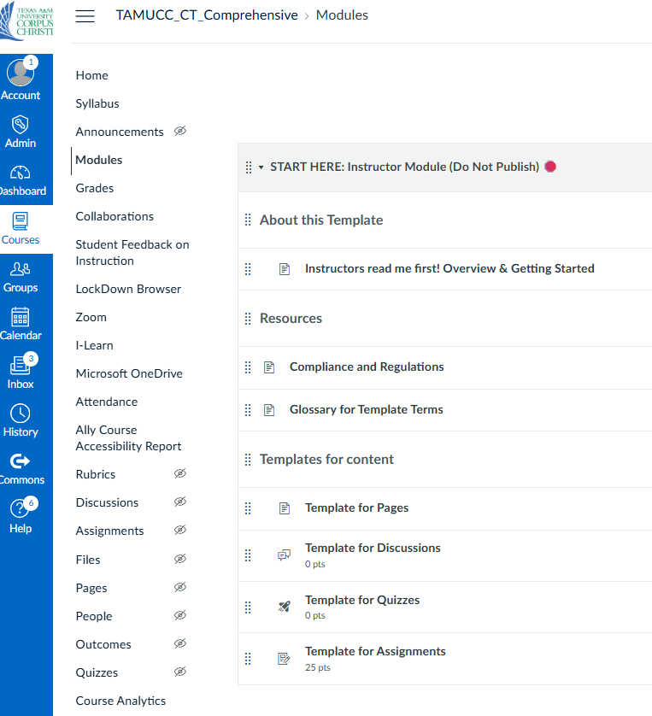
Template can be utilized to meet SRS 1.1, 1.2, 1.3, 1.4, 1.5, 1.6, 1.7, 1.8, 1.9, 2.3, 2.4, 3.2, 5.3, 5.4, 6.4, 7.1, 7.2, 7.3, 7.4, 8.1, 8.2, 8.3, and 8.7!
Content can be duplicated/filled out.

Slide 15
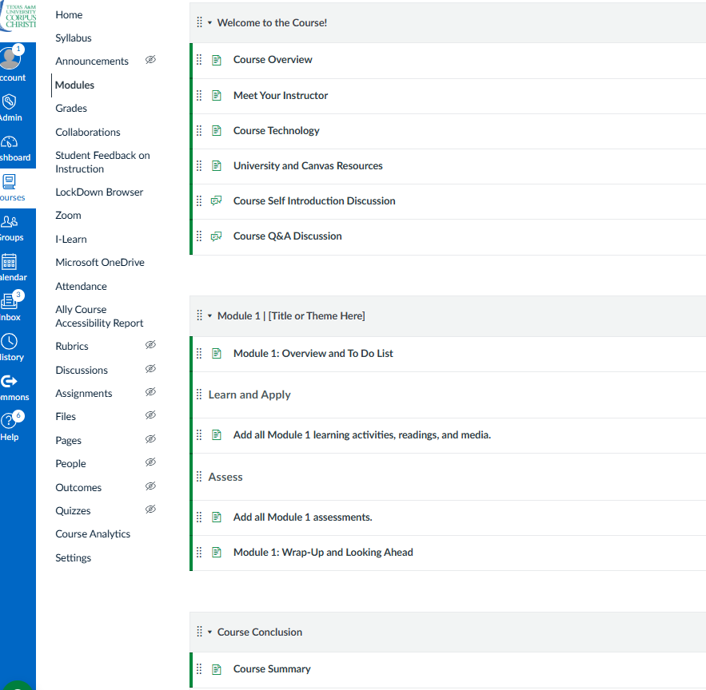
The module is cloned, then filled in with content.

Slide 16
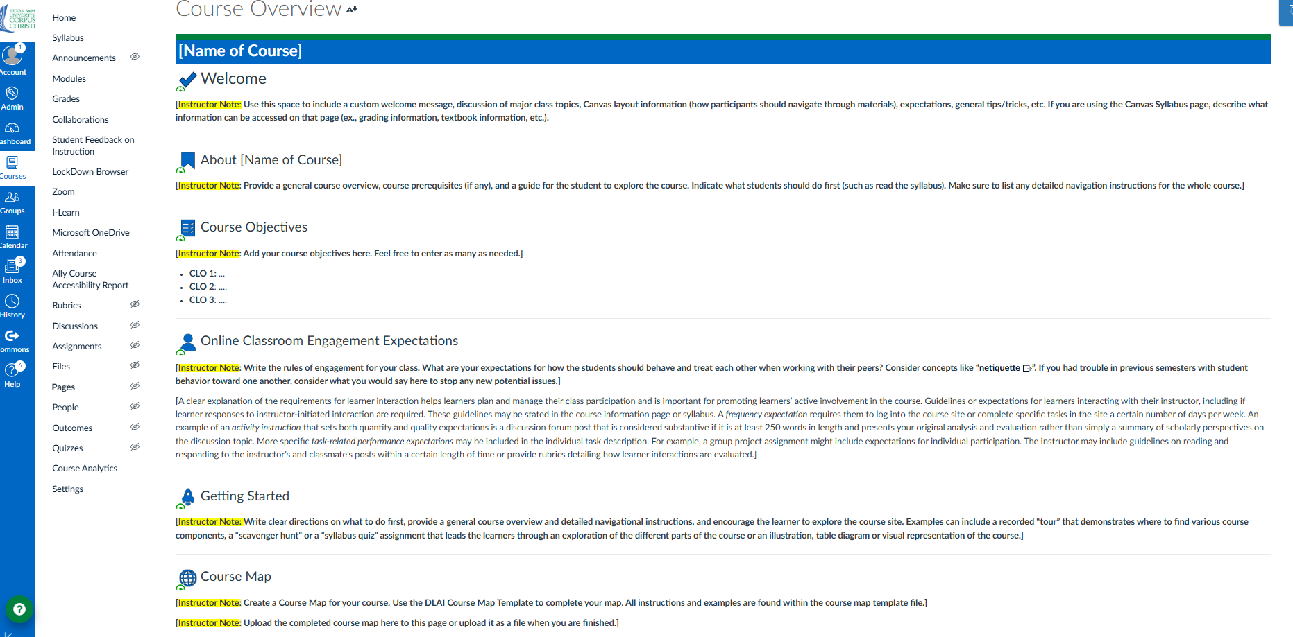
“Course Overview” templated page featuring “instructor notes” – prompts appear throughout template.

Slide 17
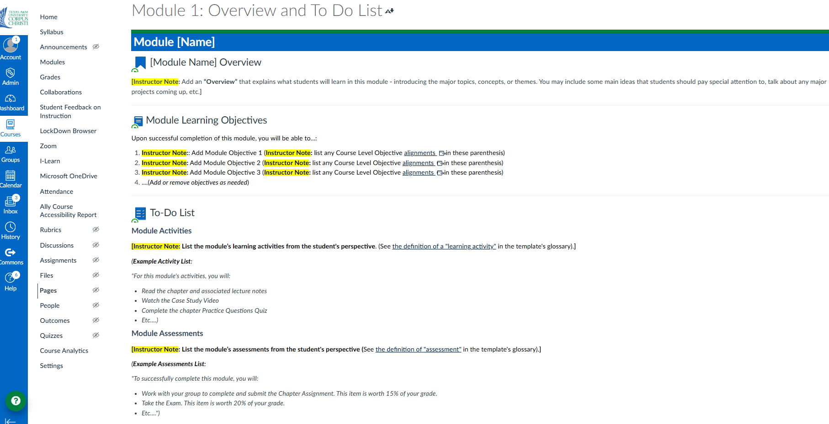
“Module overview” templated page – Instructor notes encourage consistency and clarity.

Slide 18
Stipends awarded (or not)!
Quality Assurance Program - Basic Process
1. In-take
2. Proposal
3. APPQMR
4. Kickoff
5. Course Development and ID Review*
6. Recommendation for stipend award
Bonus: QM External Review
Finish line.

Slide 19
Awaiting our first QM External Review!
Quality Assurance Program - Basic Process
1. In-take
2. Proposal
3. APPQMR
4. Kickoff
5. Course Development and ID Review*
6. Recommendation for stipend award
Bonus: QM External Review

Slide 20
Course Development and ID Review – Quarters Model
Course Development and ID Review – Quarters Model
1. Initial 1:1 Meeting
2. First quarter developed and reviewed
3. Second 1:1 Meeting
4. Second quarter developed and reviewed
5. Third 1:1 Meeting
6. Third quarter developed and reviewed
7. Fourth 1:1 Meeting
8. Fourth quarter developed and reviewed
9. Fifth 1:1 Meeting
10. All final remediations applied and reviewed
11. ID’s submit recommendations for stipend awards

Slide 21
Course Development and ID Review – Quarters Model
Course Development and ID Review – Quarters Model
1. Initial 1:1 Meeting
2. First quarter developed and reviewed
3. Second 1:1 Meeting
4. Second quarter developed and reviewed
5. Third 1:1 Meeting
6. Third quarter developed and reviewed
7. Fourth 1:1 Meeting
8. Fourth quarter developed and reviewed
9. Fifth 1:1 Meeting
10. All final remediations applied and reviewed
11. ID’s submit recommendations for stipend awards

Slide 22
Course Development and ID Review – Quarters Model
Course Development and ID Review – Quarters Model
1. Initial 1:1 Meeting
2. First quarter developed and reviewed
3. Second 1:1 Meeting
4. Second quarter developed and reviewed
5. Third 1:1 Meeting
6. Third quarter developed and reviewed
7. Fourth 1:1 Meeting
8. Fourth quarter developed and reviewed
9. Fifth 1:1 Meeting
10. All final remediations applied and reviewed
11. ID’s submit recommendations for stipend awards

Slide 23
Course Development and ID Review – Thirds Model
Course Development and ID Review – Thirds Model
1. Initial 1:1 Meeting
2. First third developed and reviewed
3. Second 1:1 Meeting
4. Second third developed and reviewed
5. Third 1:1 Meeting
6. Last third developed and reviewed
7. Fourth 1:1 Meeting
8. All final remediations applied and reviewed
9. ID’s submit recommendations for stipend awards
Slightly faster pace, faculty still supported.

Slide 24
Defunct Model – 50/50
What is missing here?
50 / 50 Model (No longer in Use)
1. In-take
2. Proposal
3. APPQMR
4. Kickoff
5. Course Dev and ID Review for the first 50% of a Map and Course.
6. Course Dev and ID Review for the second 50% of a Map and Course.
7. All final remediations applied and reviewed
8. Recommendation for stipend award
Bonus: QM External Review

Slide 25

TAMU-CC’s Journey So Far!
Our pilot!
Program | Status | Model applied
PSYO | 8 out of 13 Faculty Completed | 50/50 Model
CNEP | 3 out of 4 Faculty Completed | 50/50 Model
NURS | On Hold | On Hold
COMM | 1 out of 6 Faculty Completed | 50/50 Model
BAIS | 4 of 4 Faculty Currently Participating | Thirds Model
CLA | 4 of 8 Faculty Currently Participating | Quarters Model
COB | In Development | In Development
Independent | 1 faculty pending QM Review! | N/A

Slide 26
Our main challenges:
Scalability
Buy-in
Time
Resources

Slide 27

Poll

Slide 28
Takeaways
Frameworks ensure consistency and scalability.
Faculty and admin support is critical for sustainable quality.
Pilots provide insights for scaling successfully.

Slide 29

Q&A

