Slide 1


Is what you say you teach, what your students learn?
Using strategic design in learning and assessment

Slide 2


Thanks for joining us!
Tracy Watts
CCC Nebraska Instructional Design Consultant
Kim Vosicky
WIDS Learning Design Consultant

Slide 3
What do you use as a guide for student learning?
a. Syllabus
b. Course Outline
c. Student Learning Plan
d. Other

Slide 4
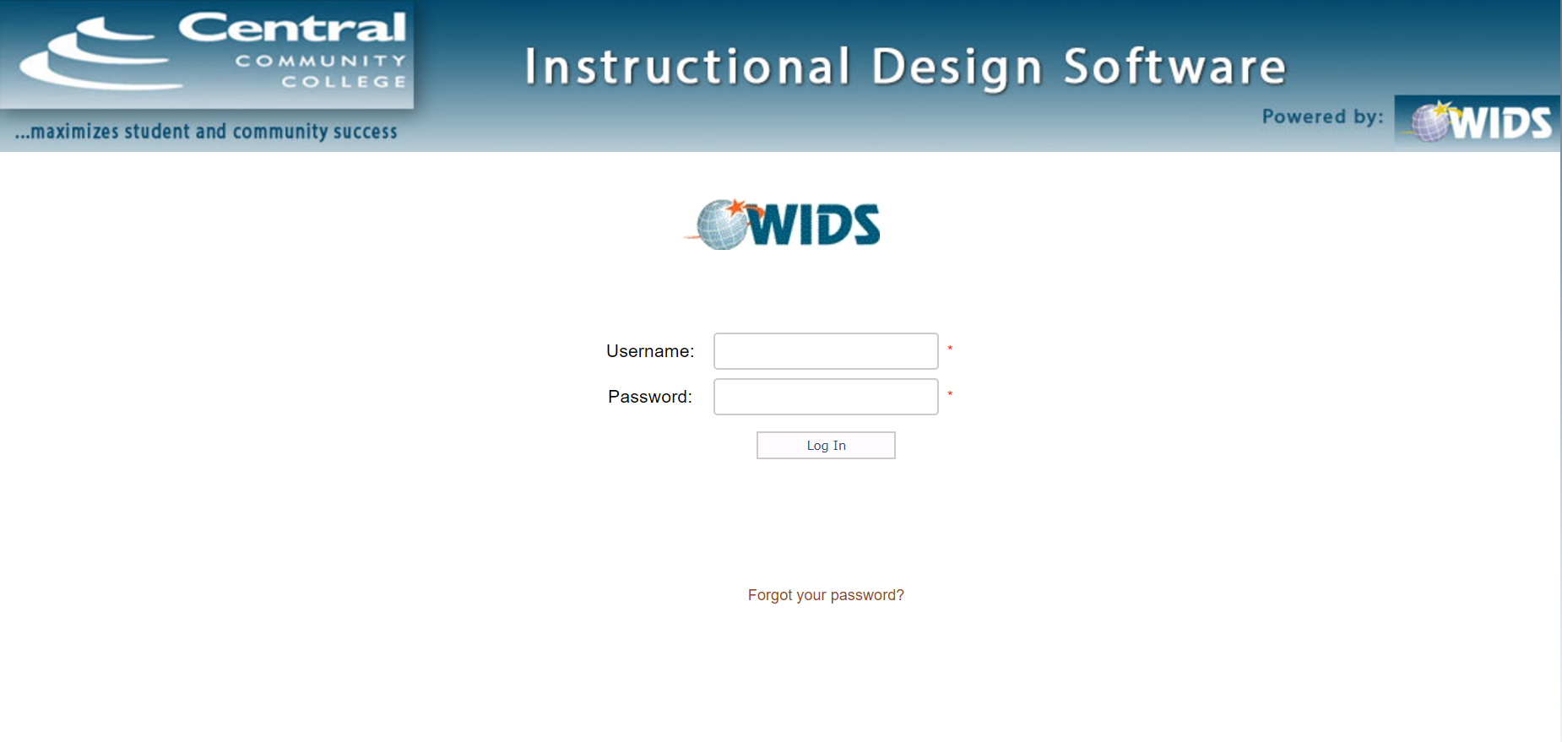
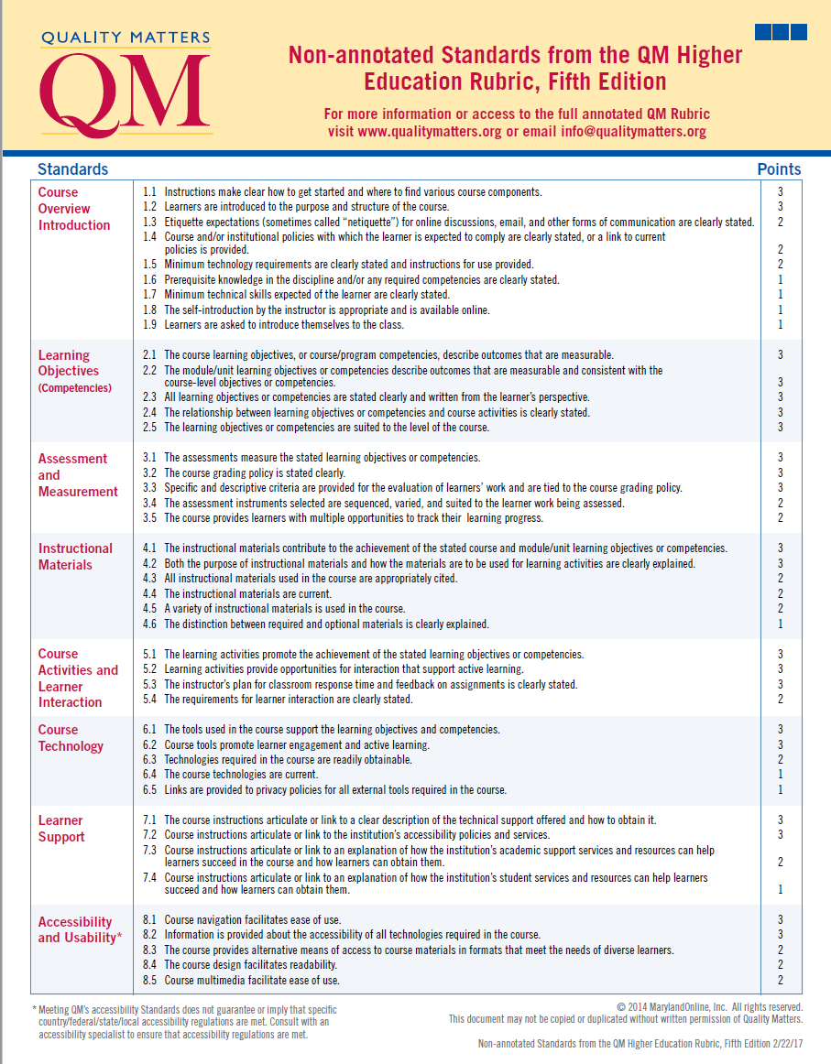
Process for Designing Instruction
CCC uses WIDS Software
CCC accountable to Quality Matters Rubric

Slide 5
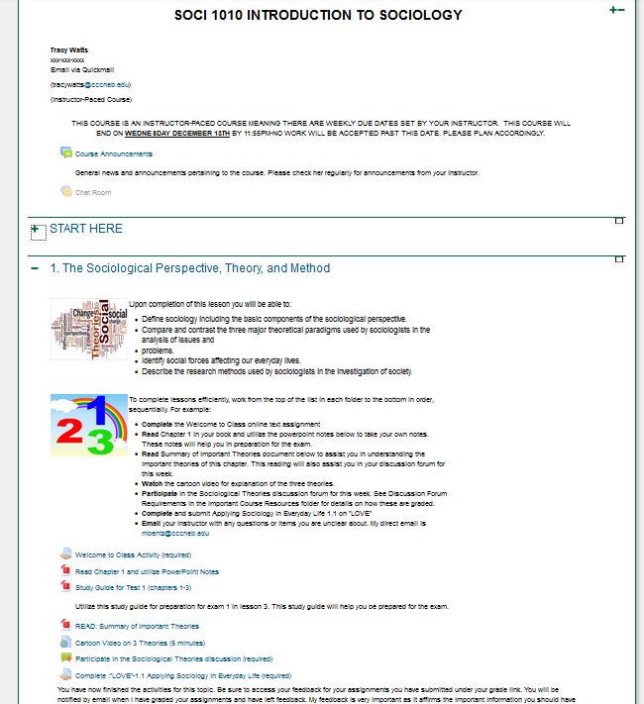
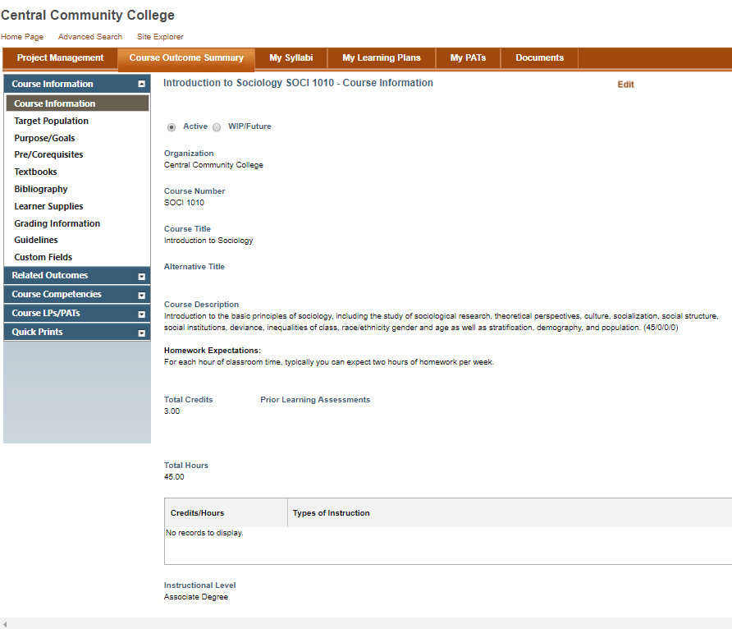

Slide 6

What questions do you hear your students consistently ask?

Slide 7


Slide 8


Slide 9
Essential Features of Performance-Based Learning
Competencies
Feature 1: Competencies are identified, verified, and made public in advance of the instruction. They are clearly stated in performance terms. Competencies answer the question, “What will the learner be able to do?”
Performance is Required
Feature 2: Performance-based learning requires the learner to perform the competency. Assessment of the competency takes the learner’s knowledge into account, but the performance is the primary evidence that the learner has mastered the competency.
Performance is Spelled Out
Feature 3: Performance standards are explicitly stated and made public in advance of assessing the performance. Performance standards provide the criteria for assessment so learners can be assessed against a pre-set standard, not against other learners.
Learning Activities
Feature 4: The learning activities and teaching strategies provide opportunities for learners to develop the competencies.
A variety of learning strategies are used
Activities provide an opportunity to practice knowledge and skills
Learners are given periodic feedback

Slide 10
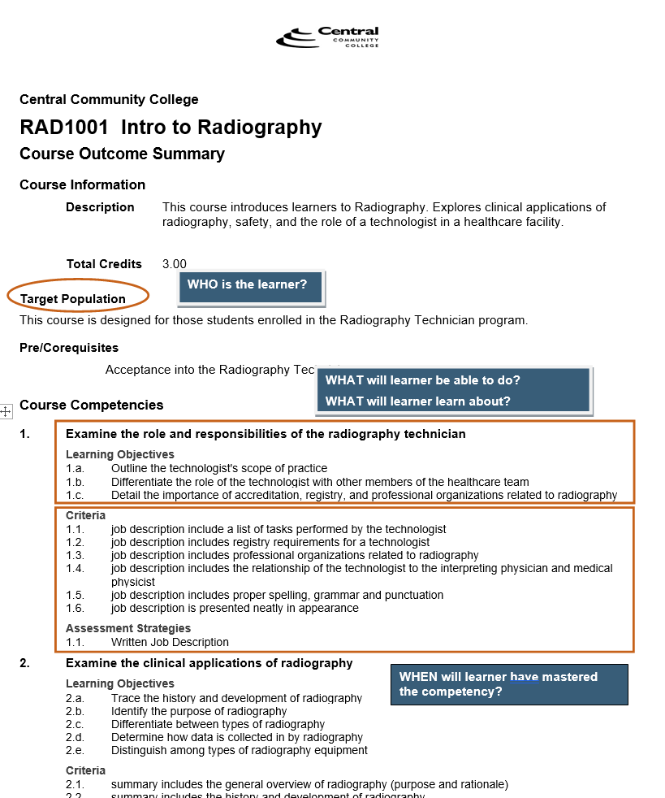
Who, What, When of Course Design

Slide 11
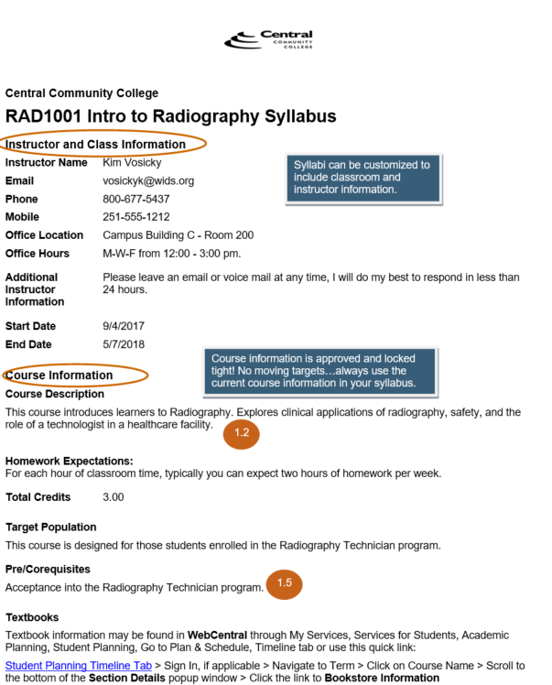
Syllabus
Developed using official course (COS) information
Addresses Essential PBL Features
Addresses QM Standards:
1.2
1.3
1.5
2.1
2.3
2.5
3.1
3.3
3.4

Slide 12
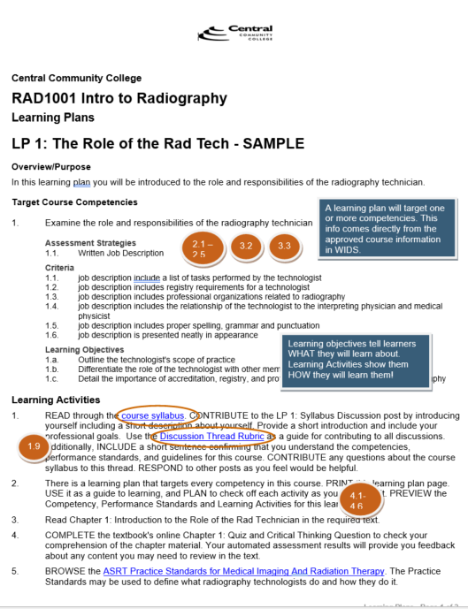
Student Learning Plans
Address the Big 10 Questions Teachers Hate
Address HOW student will learn
Relate to Quality Matters Standards:
1.9
2.1-2.5
3.2 – 3.4
4.1 – 4.6
5.1 – 5.2

Slide 13
Sound Assessment
Fair
Reliable
Valid
Valid
Outcomes based on standards (i.e. 21st Century Skills)
Measures intended outcomes
Measures application and critical thinking
Notes:
Slide is adapted for 21st Century Learning (under Valid)
13

Slide 14
Sound Assessment
Fair
Reliable
Valid
Reliable
Performance assessment based on consistent rubrics, scoring guides, and rating scales
Consistent process - each learner is assessed in same way as other learners
Notes:
Slide is adapted for 21st Century Learning (under Valid)
14

Slide 15
Sound Assessment
Fair
Valid data is fair
Reliable data is fair
Learners informed of expectations up front!
Feedback to learners
Fair
Reliable
Valid
Notes:
Slide is adapted for 21st Century Learning (under Valid)
15

Slide 16
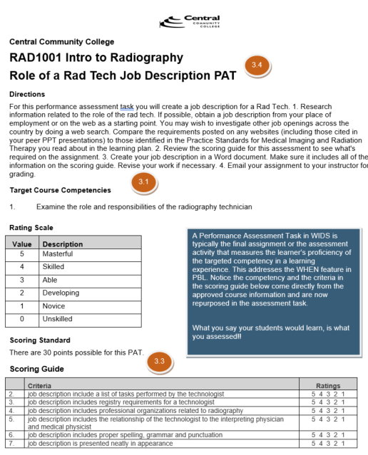
Performance Assessment Tasks
Target course competencies
Use essential and upfront performance expectations as criteria
Address the WHEN of Essential Features
Address QM Standards:
3.1
3.3
3.4

Slide 17
What feature seen today motivates you to make a change in your course design?
a. Syllabus
b. Learning Plan with detailed activities
c. Activities with linked materials
d. Performance assessment tasks with scoring guide

