Slide 1
Turning Points: Using Quality Matters to Direct Improvements in Online Nursing Programs
Ruth Fiedler, EdD, PMHCNS-BC, CNE
Associate Professor
Barbara shaw, dnp, apn, fnp-c
Assistant professor

Slide 2
Objectives
By the end of this presentation, attendees will be able to:
Describe how to institute the Quality Matters Higher Education Rubric to improve online nursing courses
Explain how to motivate faculty to revamp their course delivery methods
Explore checks and balances to ensure success in course improvement

Slide 3
background
Rush University is a private, health sciences university offering more than 30 unique degree or certificate options in medicine, nursing, allied health and biomedical research to nearly 2,000 students
The Rush University College of Nursing (CON) was one of the first in the country to develop fully online graduate nursing programs
Enrollment continues to grow, and many of our programs are ranked in the top 10 programs nationally

Slide 4

Online Courses: Student Dissatisfaction
Three major areas:
Disorganization
Out-of-date delivery methods
Lack of instructor presence in online courses

Slide 5

Barriers to improving online courses
Group Brainstorming/Nominal Group Technique:
What barriers exist at your institution that prevent faculty from making improvements to online courses?

Slide 6
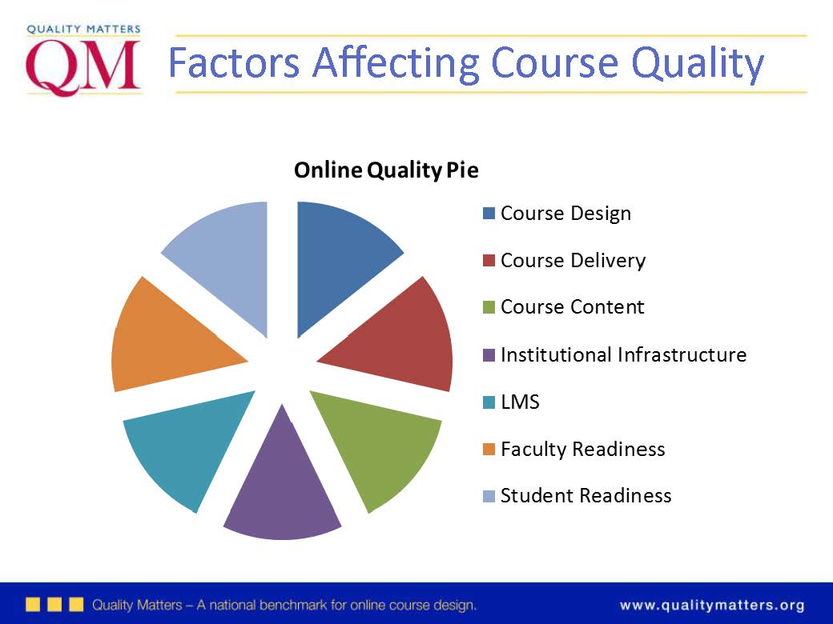
Quality Matters Comes to Rush
A Long Road to QM
Online Learning Faculty Task Force
Discovering QM
Instructional Designers
QM Reviewers at Rush
Teaching/Learning QM
One Course at a Time

Slide 7

The turning point in “getting off the dime”
Administrative backing and support for evaluation of individual courses using the Quality Matters Higher Education Rubric

Slide 8
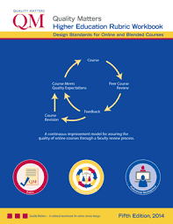
Using the Quality matters higher education rubric
The Process
Introduction to Faculty
Courses
Choices
How to Access
Evaluation
Faculty-to Faculty Feedback

Slide 9

Engagement in the improvement process
Group Brainstorming/Nominal Group Technique:
What are some strategies for motivating faculty to engage in the improvement process?

Slide 10
Motivating faculty to Improve online courses
Faculty members held accountable for course revisions
By direct line manager (department chair)
Followed up with individual faculty members to ensure adequate time and resources for revisions
By peers on the Faculty Evaluation Committee
Evaluation form developed
Faculty confirmed changes based on the peer review

Slide 11
Some of the Lessons learned
#1
#2
Utilizing the Quality Matters rubric enhanced the evaluation process and led to consistent course evaluations
Building in checks and balances was essential to ensure that faculty have the support to improve course delivery methods

Slide 12

Challenges ahead
Maintaining Direction
Checks and balances
Engagement of administration and faculty
Developing processes to maintain quality
Education re: best practices in online teaching

