Slide 1

Scalable Just-in-Time Training for Online Adjuncts Janel Heitz jheitz@bellevue.edu Instructional Training & Development Manager

Slide 2
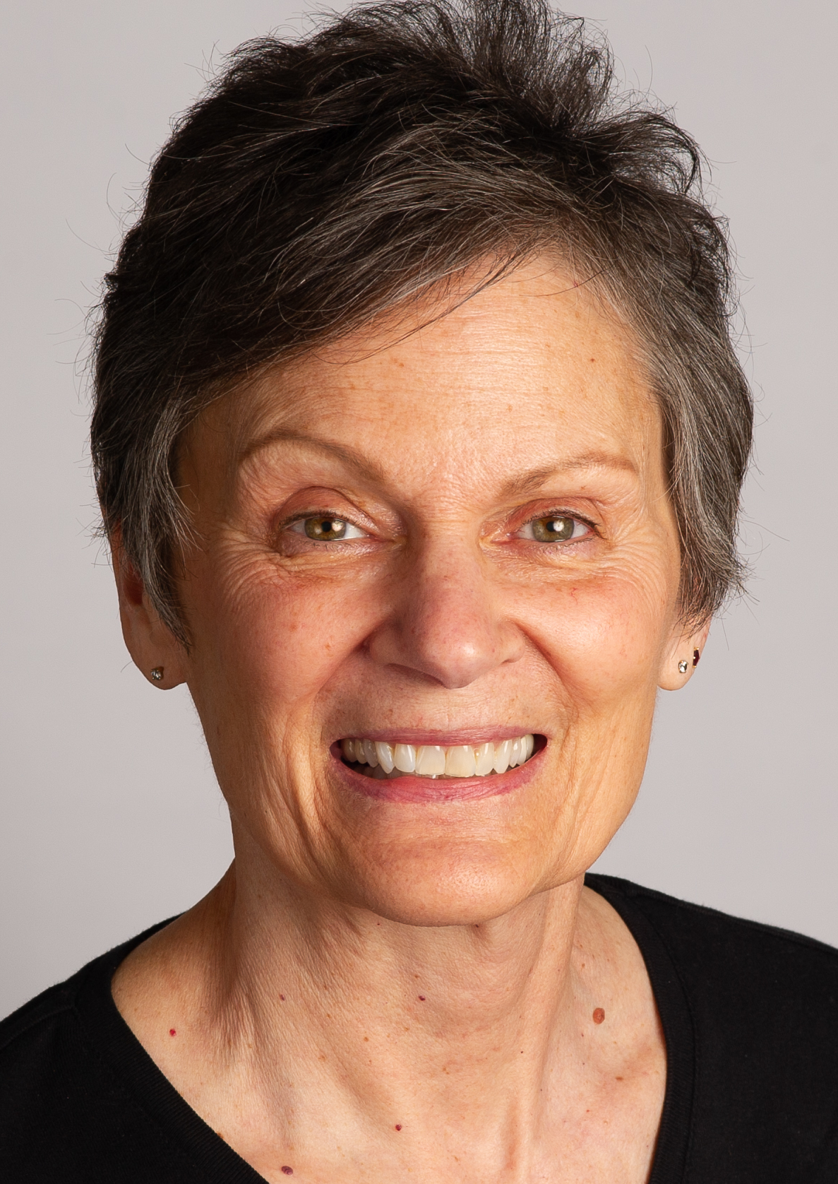
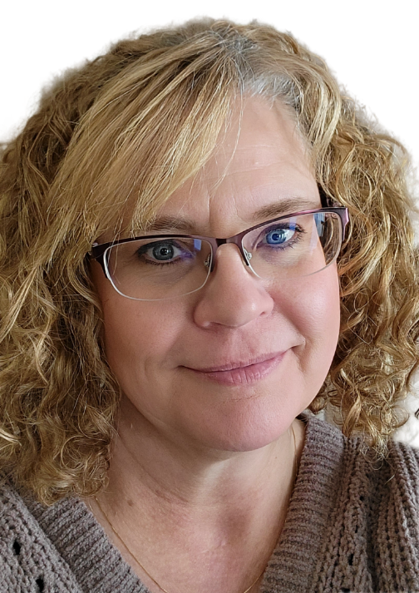
Collaborators
Kate Joeckel
Communication Studies
Program Director
Michelle Bahr
Communications Studies
Associate Professor

Slide 3
Objectives
Describe common challenges faced by adjunct faculty.
Articulate the value of adjunct instructor Training.
Identify key design features of a scalable, just-in-time adjunct training model.

Slide 4
Bellevue University
Bellevue, NE​
Private, non-profit, regionally accredited
80+ degrees​
10,000+ students​
950+ 100-level Comm Students
34 Comm Adjuncts
Notes:
Update to add info about faculty and adjuncts

Slide 5
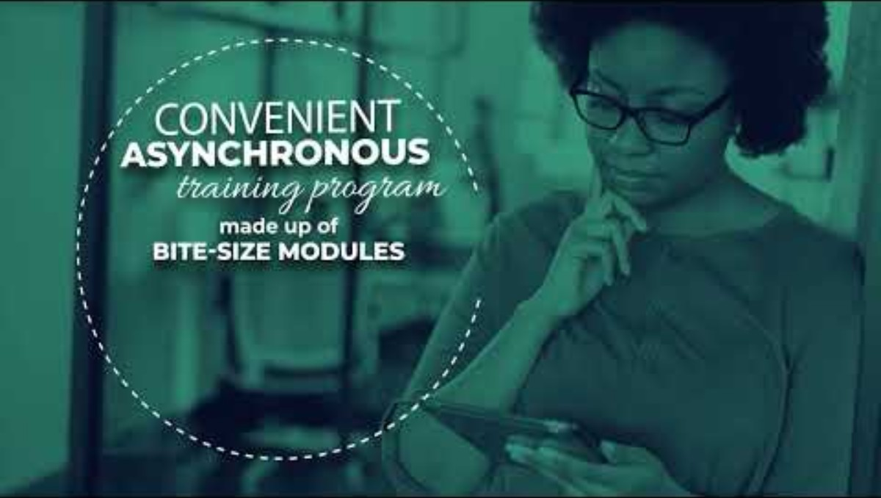
Ensuring Quality through Adjunct Training
Notes:
Video of Kate and Michelle

Slide 6
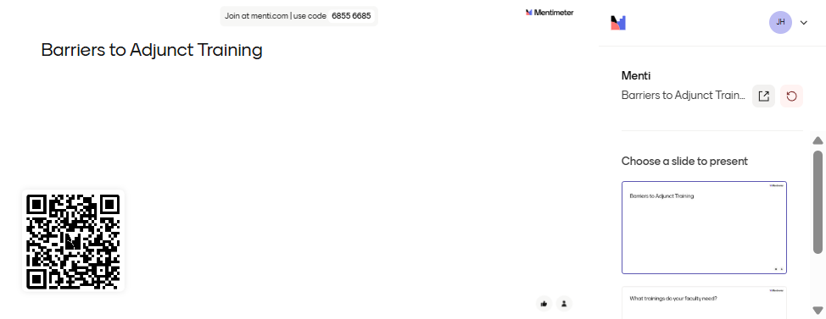
Barriers to Adjunct Training
Notes:
Word cloud/Think pair share?

Slide 7

A NEW Idea
Self-Paced
Asynchronous Community
Micro-Lessons
30 min or less
Targeted Skills
Specified by Kate & Michelle
Specific to BU
Policies/resources, course examples, and LMS

Slide 8
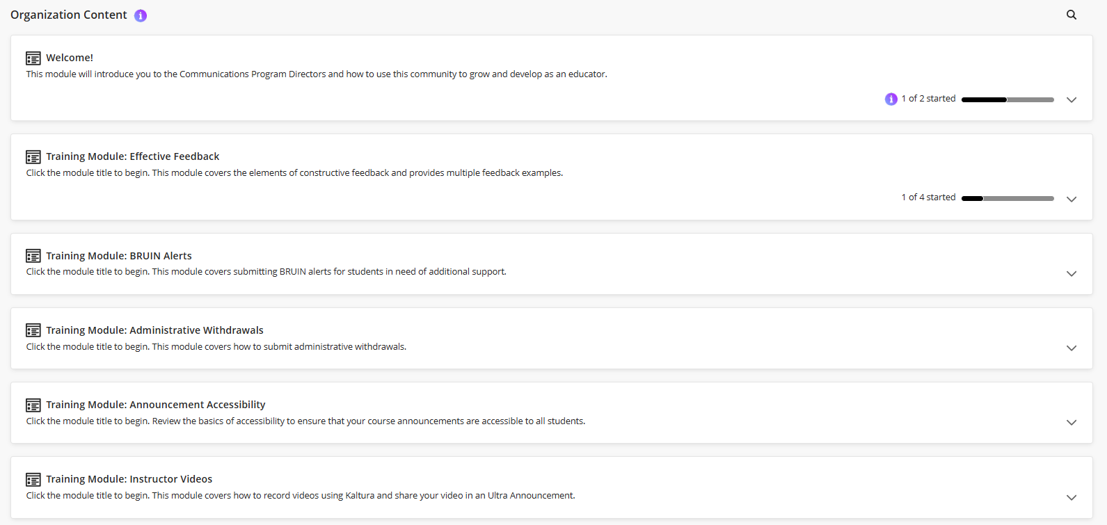
Communications Adjunct Community
Notes:
Launch Bb community

Slide 9
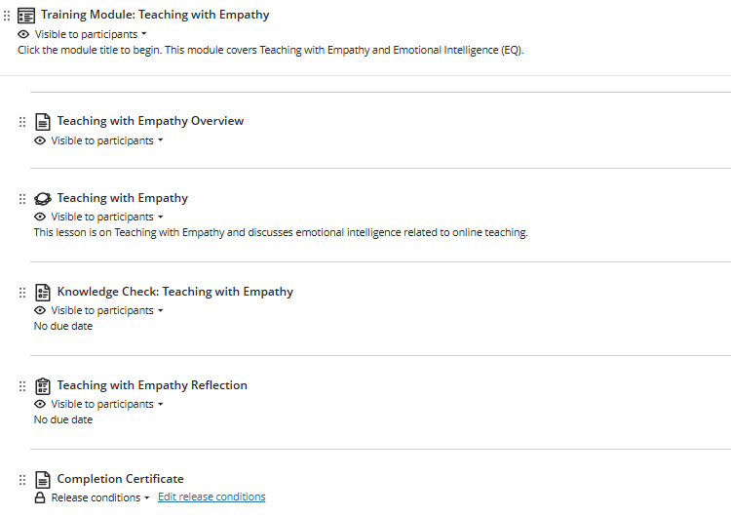
Module Layout
Overview
Articulate Lesson
Knowledge Check Quiz
Completion Certificate
Reflection Survey (new 2026)

Slide 10
Training Topics
February 2025
Effective Feedback
Announcement Accessibility
Instructor Videos
BRUIN Alerts
Administrative Withdrawals
January 2026
Teaching with Empathy
Student Academic Support
Student Support Services
Grading Policy
Writing Effective Announcements (in development)

Slide 11
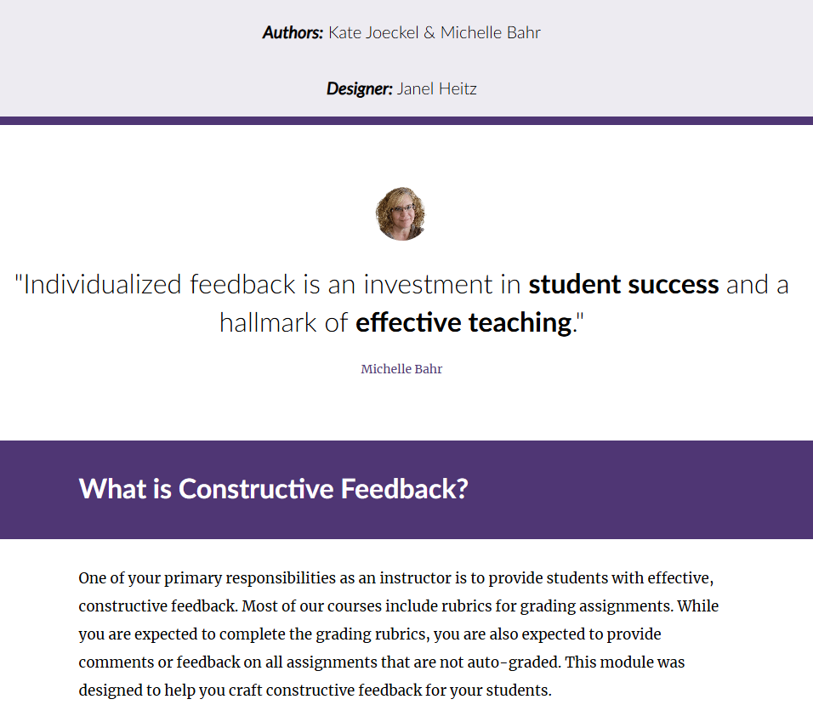

Accessing Training Lessons

Slide 12
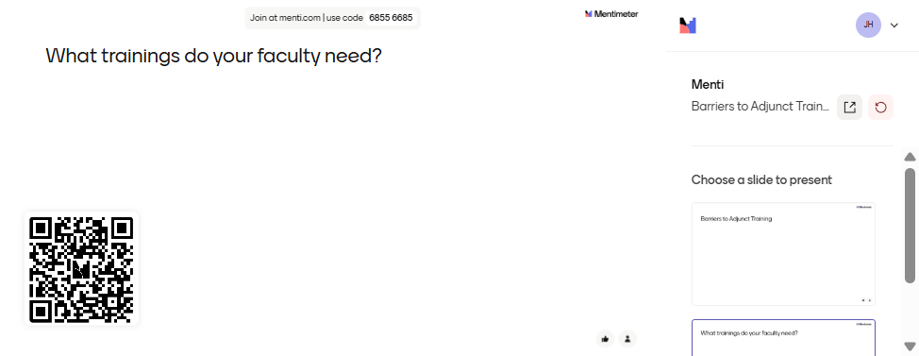
Training Topics

Slide 13

Feedback from Participants

Slide 14
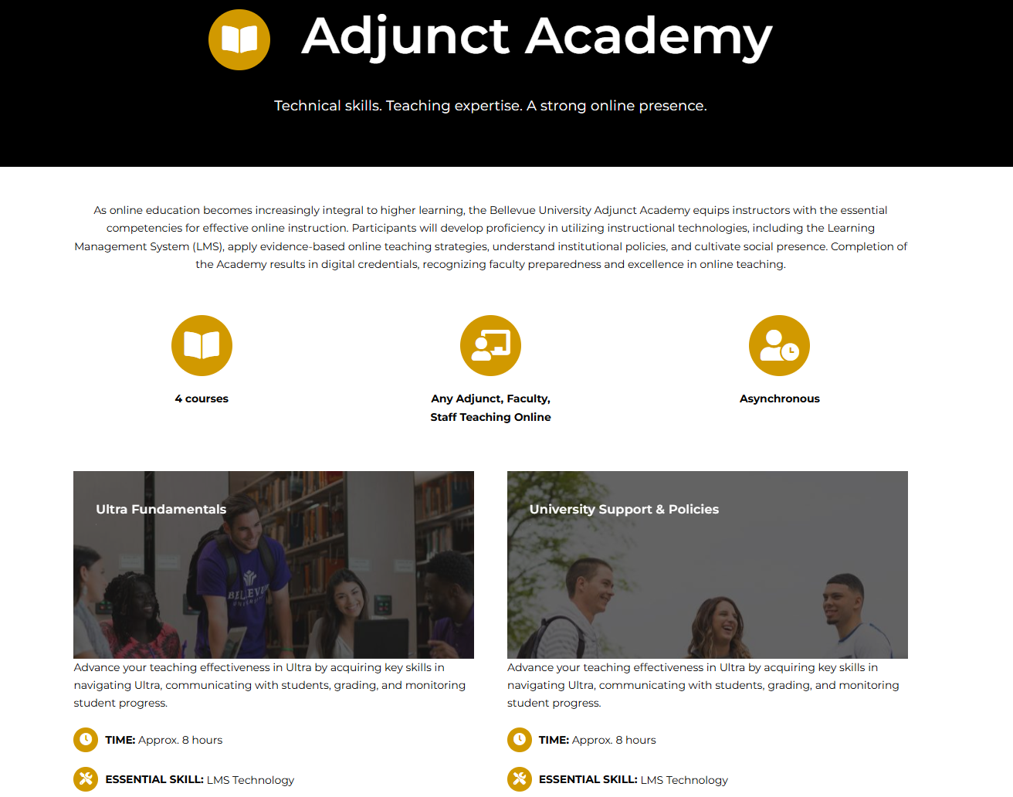
Scaling for the Future

Slide 15
QUESTIONS?

