Slide 1
Implementing a Plan for Digital Accessibility
Heather Caprette, M.F.A. Sr. Media Developer/Instructional Designer CSU Online, Cleveland State University

Slide 2
Goals for Today
Explain what accessibility means
Explain the laws and standards that ask for accessible online content
Share resources and methods for implementing accessibility

Slide 3
What is Accessibility
The degree to which a product, service or facility is available to all people. ¹ In online design, it means the degree to which a content management system and the content are available to people with disabilities.
¹ Quality Matters, Addressing Accessibility & Usability Workshop
Notes:
We say “degree to which” because accessibility is a range. It’s not possible to make everything accessible to everyone. There are a diversity of disabilities and what helps one user, may not help another. Some users do not prefer to have media play on a page as soon as it loads, but if a user has a motor impairment that makes it difficult to use a computer and navigate a website, say they are using a mouth wand, or tabbing through elements on a page to get to what they need, they may enjoy having the media play automatically without interaction from them.

Slide 4
What is Accessible – Office for Civil Rights
“Accessible means a person with a disability is afforded the opportunity to acquire the same information, engage in the same interactions, and enjoy the same services as a person without a disability in an equally effective and equally integrated manner, with substantially equivalent ease of use.”2
² Resolution Agreement South Carolina Technical College System OCR Compliance Review No. 11-11-6002, http://www.sbcc.edu/dsps/instructionalformats/
Notes:
With the South Carolina Technical College System, the Office of Civil Rights found:
Findings of Fact included:
- Inaccessible PDFs
- Videos with no captions, delivered in inaccessible media players (controls without labels, not operable by keyboard)
- Insufficient alt text on images
- Form fields with no labels
- Inaccessible drop down menus
- Accessibility features missing from the content within course management systems
- Campus calendars not accessible to screen readers
For something to be accessible, it needs to be presented to a person with a disability in the same ….

Slide 5
What does Disability Mean?
A disability is a physical or mental impairment that substantially limits one or more major life activities of an individual;
Major life activities include, but are not limited to, caring for oneself, performing manual tasks, seeing, hearing, eating, sleeping, walking, standing, lifting, bending, speaking, breathing, learning, reading, concentrating, thinking, communicating, and working.
A major life activity also includes the operation of a major bodily function, including but not limited to, functions of the immune system, normal cell growth, digestive, bowel, bladder, neurological, brain, respiratory, circulatory, endocrine, and reproductive functions.
http://www.ada.gov/pubs/adastatute08.htm#12102
Notes:
Disability refers to many life activities, but we’ll focus on how to design for visual, hearing, motor and some cognitive disabilities. Cognitive disabilities is the hard one because they are diverse in nature.

Slide 6
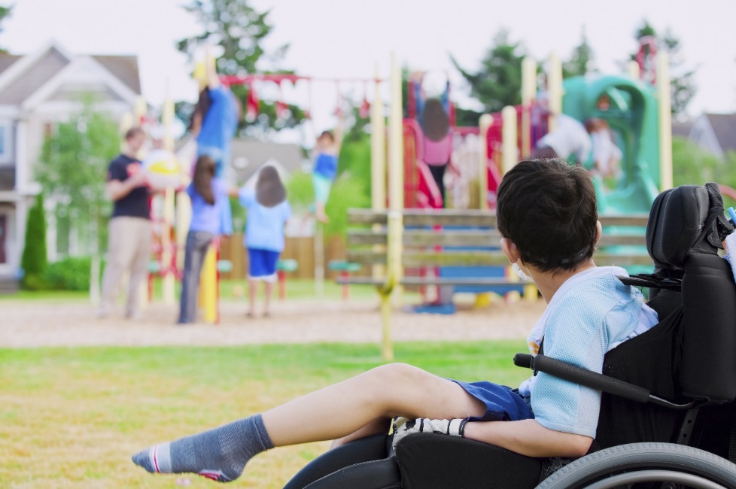
Why Design Accessible Experiences?
Notes:
If you’ve ever experienced being excluded from an activity you wanted to participate in, you’ll understand that designing inclusive experiences is the right thing to do. Coming from an academic perspective, we’d like everyone to have the opportunity to learn, share, be creative and succeed in life. We’re here to enrich people’s lives and provide information to everyone. We are here to open doors to information.

Slide 7

Why Design Accessible Experiences Continued
Notes:
Moreover, providing access to programs and services is the law. With a larger shift to online learning, it’s important that we have accessible learning materials and systems.

Slide 8
What are the Laws – Section 504
Section 504 of the Rehabilitation Act of 1973
www.dol.gov/oasam/regs/statutes/sec504.htm Section 504 of the Rehabilitation Act of 1973, says that colleges or universities that receive federal funds need to ensure that people with disabilities can participate in programs & activities and have the same benefits that people without disabilities have. Subpart E requires an institution to be prepared to make reasonable academic adjustments and accommodations to allow students with disabilities full participation in the same programs and activities available to students without disabilities.
Notes:
There are three laws to be aware of when building online content. Section 504 of the Rehabilitation Act of 1973, says that colleges or universities that receive federal funds need to ensure that people with disabilities can participate in programs & activities and have the same benefits that people without disabilities have. Subpart E requires an institution to be prepared to make reasonable academic adjustments and accommodations to allow students with disabilities full participation in the same programs and activities available to students without disabilities.

Slide 9
What are the Laws – Section 508
Section 508 (Electronic and Information Technology), The Rehabilitation Act of 1973 Amended in 1998 Section 508 of the Rehabilitation Act of 1973 is an amendment that refers to electronic information and communication technology. If you are a state that receives federal funds under the Technology Related Assistance for Individuals with Disabilities Act of 1988, you need to ensure that people with disabilities have access to and can use information and services available to non-disabled members of the public. * This includes information stored on web sites and in online courses.
Notes:
Section 508 of the Rehabilitation Act of 1973 is an amendment that deals with electronic information and communication technology. If you are a state that receives federal funds under the Technology Related Assistance for Individuals with Disabilities Act of 1988, you need to ensure that people with disabilities have access to and can use information and services available to non-disabled members of the public. This includes information stored on web sites and in online courses.
There is also the Americans with Disability Act of 1990 which extends the Rehabilitation Act of 1973 to private universities, requiring them to make their websites, online courses, and facilities accessible.
It requires schools to provide access to the same programs that non-disabled people participate in, in an integrated setting where possible. It requires auxiliary aids and services when necessary to ensure effective communication.

Slide 10



What are the Guidelines
Section 508 Rules require conformance to the Web Content Accessibility Guidelines (WCAG) 2.0 at Level AA - (https://www.section508.gov/develop/applicability-conformance)
WCAG 2.0 – (https://www.w3.org/WAI/standards-guidelines/wcag/
How to Meet WCAG - Quick Reference guide – (https://www.w3.org/WAI/WCAG21/quickref/?versions=2.0)
P – Perceivable
O – Operable
U – Understandable
R - Robust
Level AAA
Level AA
Level A
Notes:
The four WCAG Accessibility Principles:
P – Perceivable - Information and user interface components must be presentable to users in ways they can perceive.
O – Operable - User interface components and navigation must be operable.
U – Understandable - Information and the operation of the user interface must be understandable.
R – Robust - Content must be robust enough that it can be interpreted by a wide variety of user agents, including assistive technologies.
There are three levels of conformance to WCAG criteria: A, AA, and AAA, with AAA conformance providing the best accessibility. WCAG is now on version 2.2 as of October 5, 2023 as recommended guidelines. Still, 508 asks for compliance with WCAG 2.0 Level AA.

Slide 11

QM G.S. 8: Accessibility & Usability
The course design utilizes principles of accessibility and usability, reflecting a commitment to ensuring diverse learners can access course content and activities and can easily navigate and interact with course components.
2023 Quality Matters
Notes:
General Standard 8 within the 7th Edition of the QM Higher Ed Rubric asks for accessibility and usability of online courses.

Slide 12
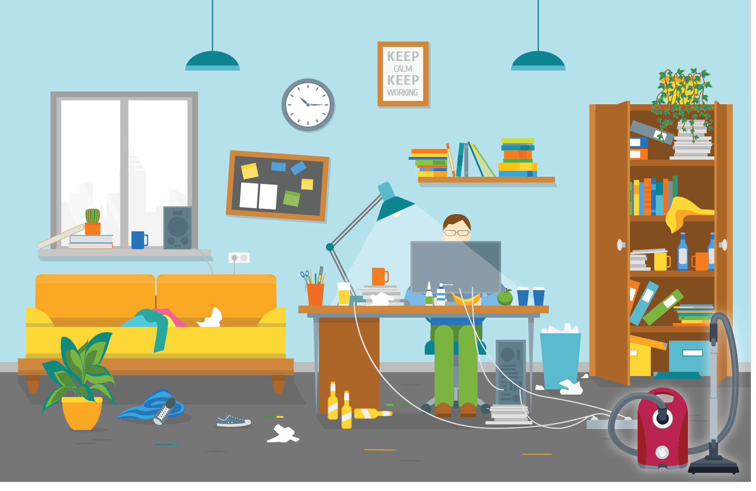
Challenges to Getting Started
Notes:
In chat, what are your challenges with getting started or implementing accessibility at your institution? Would you like to share solutions you’ve found for implementing accessibility at your institution? Considerations for implementing digital accessibility in your online courses:
Just in time resources for faculty who need to learn this when they have a student with a disability in their course.
Can pick a staff member to take digital accessibility training and design professional development short courses for faculty, or put together web resources for them. If there is a small grant opportunity for a group of staff from an institution to take accessibility training courses, you could apply for this. SEIU offered $2000 grant for 10 staff to take Deque University’s suite of document and web accessibility courses. See dequeuniversity.com
If funding available, a stipend can be a reward for faculty who successfully complete a short course on digital accessibility.
OSU had Unity Awards issued by the ADA Coordinator’s Office – students with disabilities would nominate faculty, staff or Graduate Teaching Assistants who implemented accessibility principles in their course, or made strides to help them. Form of recognition.
Create Accessibility Resources pages in your course template for students with disabilities to learn more about where they can get accommodation at your institution, and to learn about accessibility features of the technology you use.

Slide 13
QM Resources on Accessibility
QM Accessibility and Usability Resource Site (AURS) course
Register at qmprogram.org/myqm > Select Workshop
Addressing Accessibility & Usability - QM Professional Development Workshop (Online or Virtual workshop course)
New Book: Guide to Digital Accessibility: Policies, Practices, and Professional Development, Edited by Rae Mancilla, Ed.D. and Barbara Frey, D.Ed.
QM Digital Accessibility White Papers
3 papers that summarize the accessibility policies and practices of QM members, and make recommendations in developing inclusive online materials
Notes:
The Accessibility & Usability Resource Site – Register after logging into MyQM qmprogram.org/myqm/ > Select Workshop – Register and then choose “Register for Accessibility & Usability Resource Site.” Once registered, Click on Classroom to go to QM’s Canvas site. Find it listed under Courses. Provided practical ways to meet QM standard 8. Good resource if you lack staffing and funding to create a professional development course for your faculty. Touches on many areas related to the QM general standard 8.
The Addressing Accessibility & Usability workshop will help you develop accessibility resources and accessible content for your online course. It will give you a hands-on opportunity to apply accessible formatting.
Guide to Digital Accessibility: QM Members Receive a 20% Discount, Order the Guide to Digital Accessibility and receive a 20% discount off the $39.95 list price (total with discount = $31.96). QM Members can email research@qualitymatters.org with the subject line “Guide to Digital Accessibility Discount” to receive a discount code for the paperback or e-book. (Shipping on the paperback edition is free.) It provides examples of successful accessibility implementation and is a practical resource for instructors, administrators and staff working to make online and hybrid learning accessible. Compiles the experiences of the authors and their teams at a wide variety of higher education institutions.
QM Digital Accessibility White Papers summarize the results of a 2019 survey of QM member organizations on their policies and practices in making online learning accessible. Titles are: Administrative Supports for Digital Accessibility: Policies & Practices, Course Design for Digital Accessibility: Best Practices and Tools, and Professional Development for Digital Accessibility: A Needs Assessment.

Slide 14
SRS 8.1 Course Navigation - 1
Course navigation facilitates ease of use.
Consistent layout and design
Repetitive design elements for recurring activities (icons and titles)
2023 Quality Matters
Notes:
An LMS will use specific icons for various built-in tools, like assignments, documents, discussions, etc. But, we can also help out LMSes that don’t have something built in already to let the learner know where they are at.

Slide 15
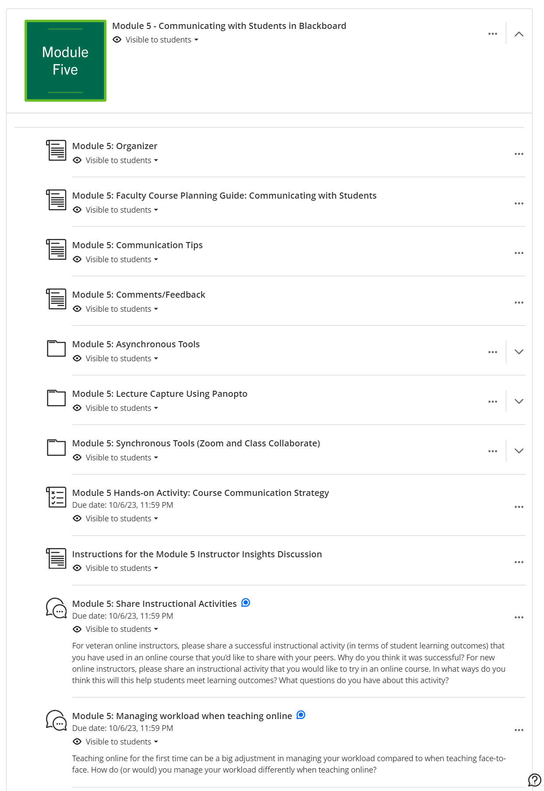
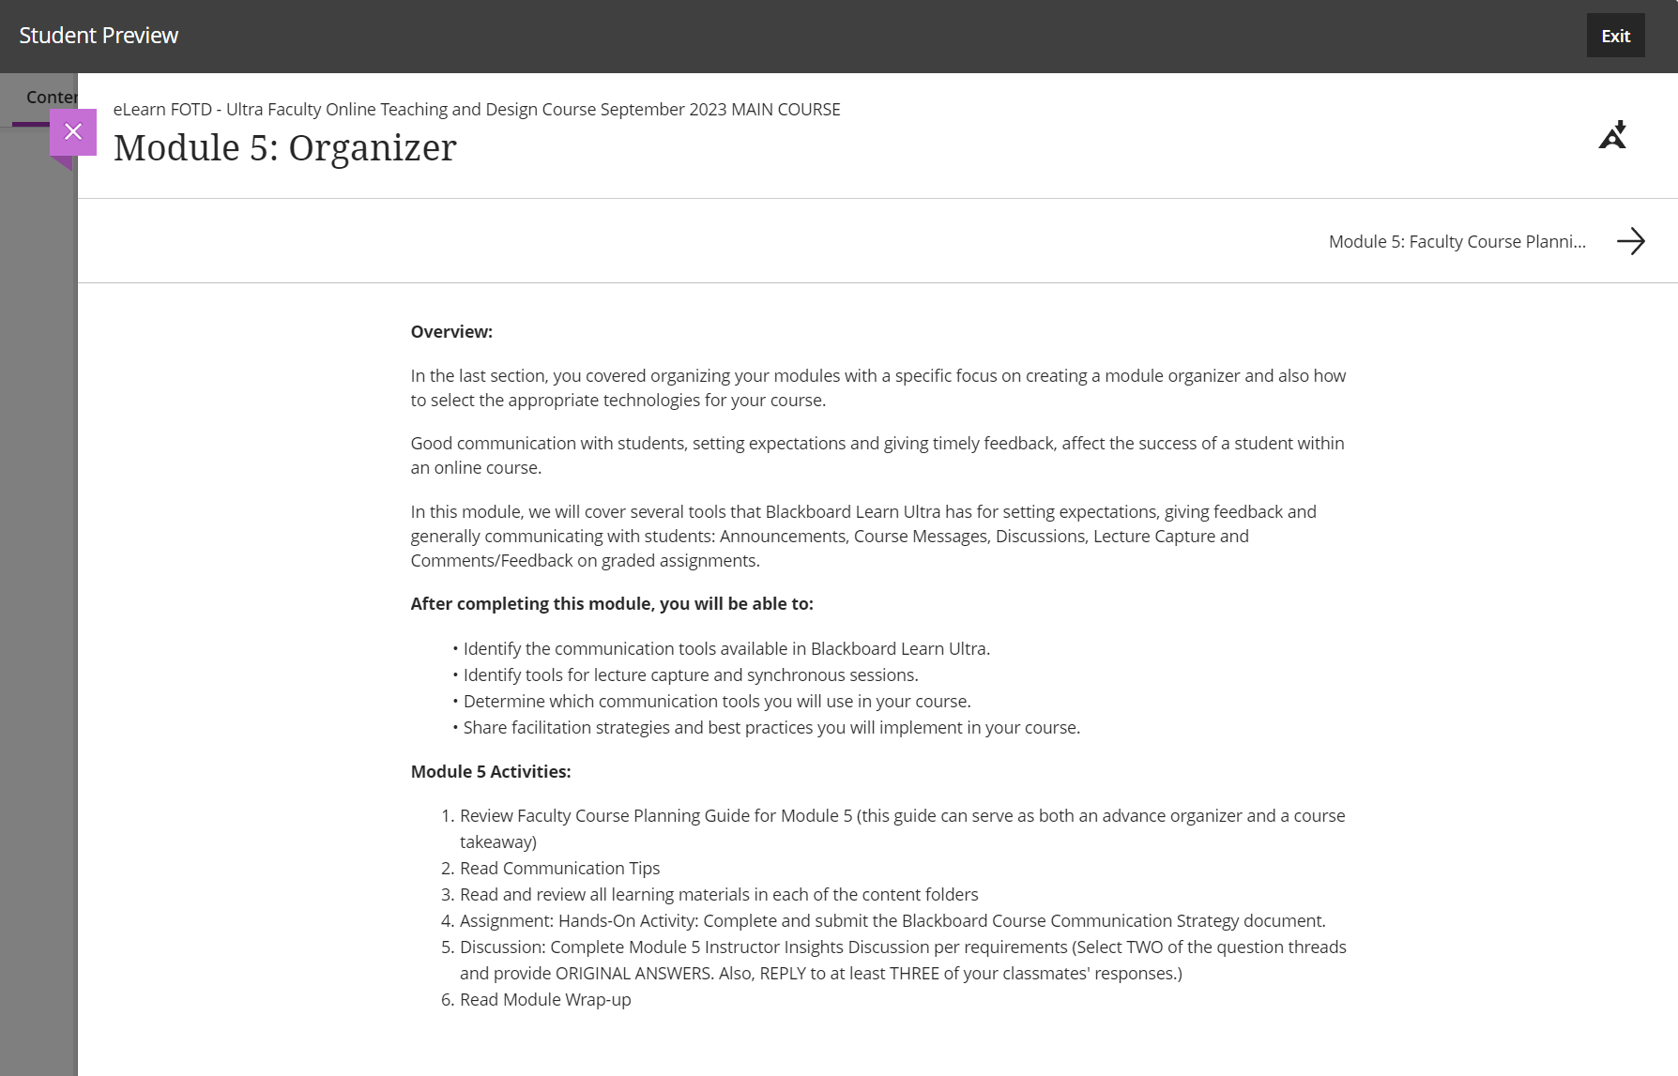
Example of Consistent Layout Convention
Our given title for the document in Blackboard Ultra course view helps the student identify where they are at.
Notes:
Blackboard LMS has built in icons for various elements: documents, folders, assignments, discussions, etc. See the screen shot on the left. The newer Blackboard Ultra interface did away with bread crumb trails. Student can’t see what module they are in after entering into a learning module. The text “Module 5” is added to the documents, subfolders, assignment and discussions to let user know which learning module they are in. This helps when they are in learning module layout, as seen in the right screen shot.

Slide 16
SRS 8.1 Course Navigation - 2
Descriptive hyperlink text
Reserve underline style on text for links only
Notes:
Don’t use underlining to emphasize important text. It’s a common accessibility error. Linked text should tell the user where the link goes to. Avoid “click here” or “read more” links.

Slide 17
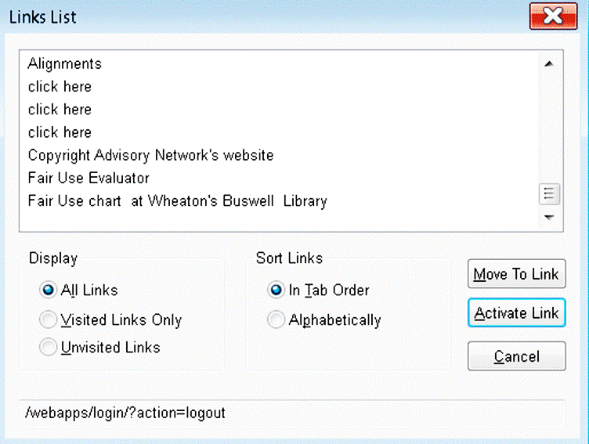
Example of non-descriptive vs. descriptive text links
Avoid this type of writing and linking:
"For more information about Fair Use of copyrighted materials, click here. For information about a Fair Use Evaluator that can help you decide if your specific use of copyrighted material favors Fair User or not, click here. For a chart that shows a list of conditions that favor or oppose Fair Use, click here.
How you could reword the text to provide descriptive text links:
"More information about Fair Use of copyrighted materials can be found on the Copyright Advisory Network's website. If you have a question about whether a use falls under Fair Use or not, you can take the Fair Use Evaluator on their site. There is also Fair Use chart at Wheaton's Buswell Library, that you can use as a quick guide to see if your use of copyrighted materials is favoring or opposed to Fair Use."

Slide 18
SRS 8.2 Readability - 1
The course design facilitates readability.
Group similar content together, use white space
Few errors in spelling, grammar, punctuation, syntax, word choice
Font style and size maximize on-screen legibility
Consistent heading and body styles
Use consistent headers for activities/assessments, e.g. “instructions,” “grading information.”
A table of contents is included in a long document that allows easy navigation
2023 Quality Matters
Notes:
Applying Word Heading Styles is required for QM SRS 8.3, but this method helps meet other accessibility standards. A Table of Contents in a long document not only helps people who are blind and using a screen reader, but helps all learners navigate to specific sections. When you use Word’s built in Heading styles for your headers, and the Normal style for body text, it will help with consistency. Reference Ribbon has Table of Contents creation tool in Word.
Examples of good sans-serif fonts to use are Arial, Verdana, Tahoma, Myriad Web Pro, Trebuchet, or Roboto. Serif font families with good stroke weight and spacing for online display are Georgia, Times New Roman, and Times. Sans-serif is best for body text on screen.
Watch out for long line length. The eyes need to pause to rest during long sentences. Ideally, line length would be 1 to 1.5x the length of the alphabet for a font face (per CSU Design instructor).

Slide 19
SRS 8.2 Readability - 2
Color contrast between text and background should meet WCAG standard
Text is formatted to serve specific instructional purposes.
Can use color for specific purposes, but make sure color alone is not used to convey meaning
Notes:
Examples of formatting for instructional purpose: We always list our measurable learning objectives in a numbered list within a module organizer at the beginning of a learning module.

Slide 20
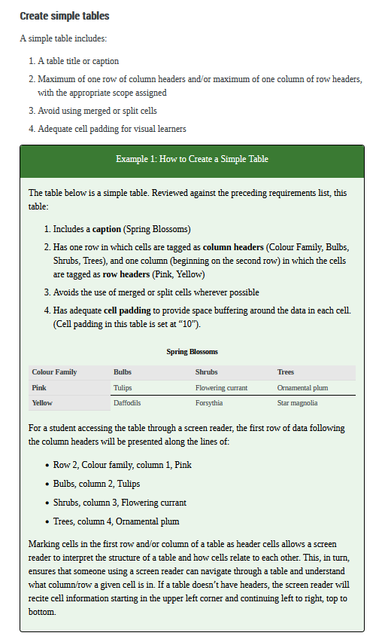
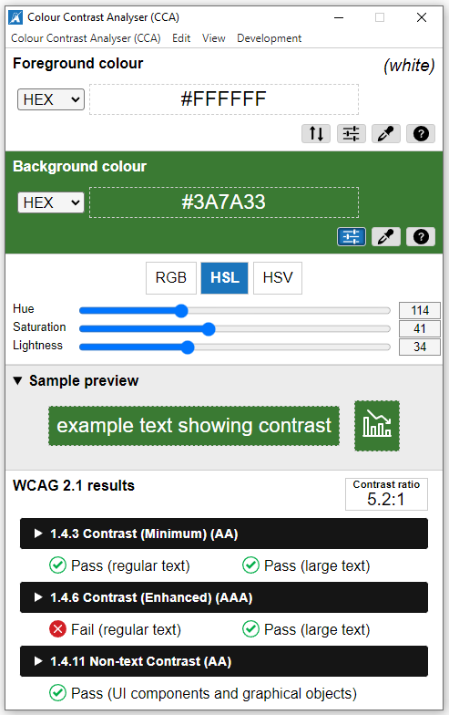
Example of use of color and good color contrast
Download the free Colour Contrast Analyser – for Windows and Mac
Notes:
Pressbooks is an authoring platform for faculty who write their own textbooks. The image on the left shows an example of the use of color for instructional purposes. A green call out box is used to explain and display an examples throughout the text. Here it is an example of a simple accessible table. It also contains good color contrast. The middle image shows the use of Colour Contrast Analyser, a free tool to check to see if the foreground text against the background color meets WCAG standard for color contrast. Regular size text (12 point) should have a ratio of 4.5:1 with its background to meet level AA. Large text, 14 pt bold, or 18pt regular weight only needs a 3:1 contrast ratio with background color.

Slide 21
SRS 8.3 Text Accessibility – 1
Text in the course is accessible.
Avoid images of text, e.g. scanned articles and chapters from books. Text should be searchable.
Use library Permalinks to full-text articles or eBooks when possible
Can use Optical Character Recognition
Notes:
If you have a PDF you would like to use online, you can open it with Adobe Reader to check for some accessibility features. If a PDF is accessible, it will have tags and searchable text. Tags are the structural elements, similar to HTML elements, that provide semantic meaning to the content on the page. There are tags for headings, paragraphs, images, lists, tables, and table headers for example. It is these tags, much like Word Styles and properly marked up HTML, that help people using assistive technology and devices navigate the page and understand what content is.

Slide 22
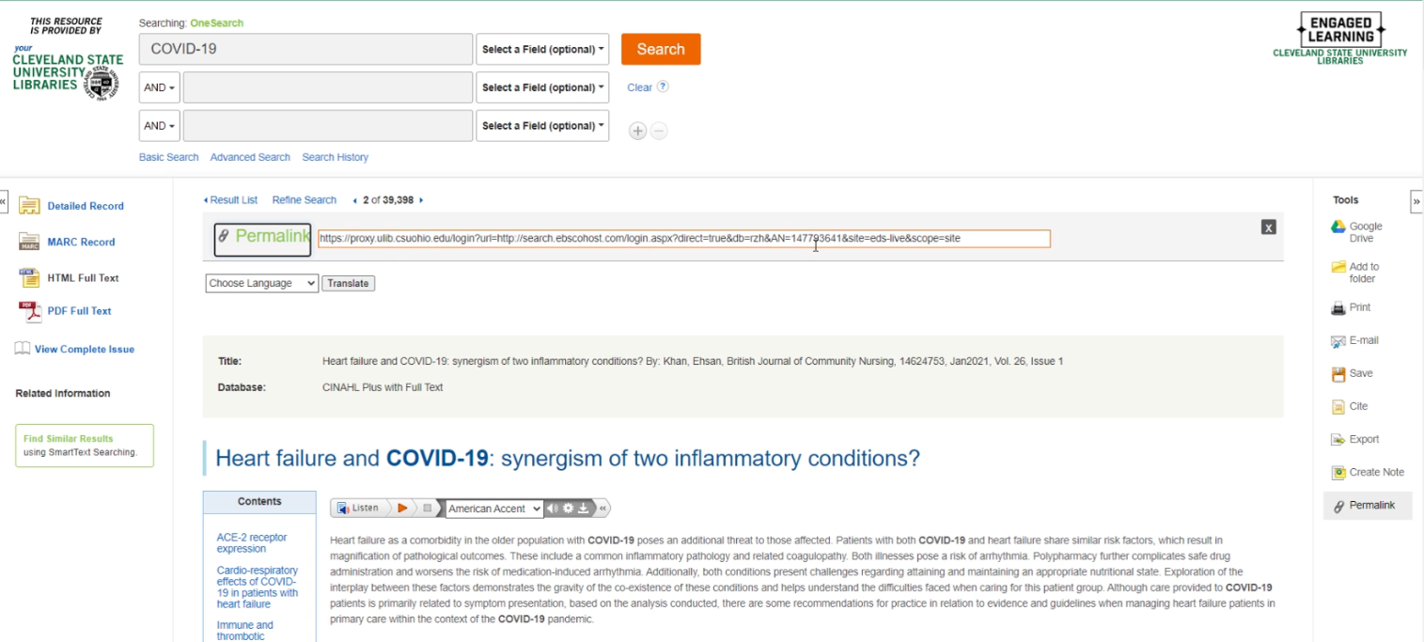
Example of a library Permalink, also an HTML Full Text Article
Notes:
Look for the “Permalink” for the URL to an article that your library has paid for. You can use this Permalink URL as a Web Link within your LMS. Notice the ReadSpeaker play bar just above the body text of the full-text article. It will read the article back to students. Can help students with a reading disability, such as dyslexia. Can also help English Language learners who don’t natively speak English. Text-to-speech assistive technology in general helps people with learning and speech disabilities, visual impairments, and low literacy challenges. 15-20% of the world’s population has a language-based learning disability. It can improve comprehension, language skills, and autonomy of struggling readers.

Slide 23
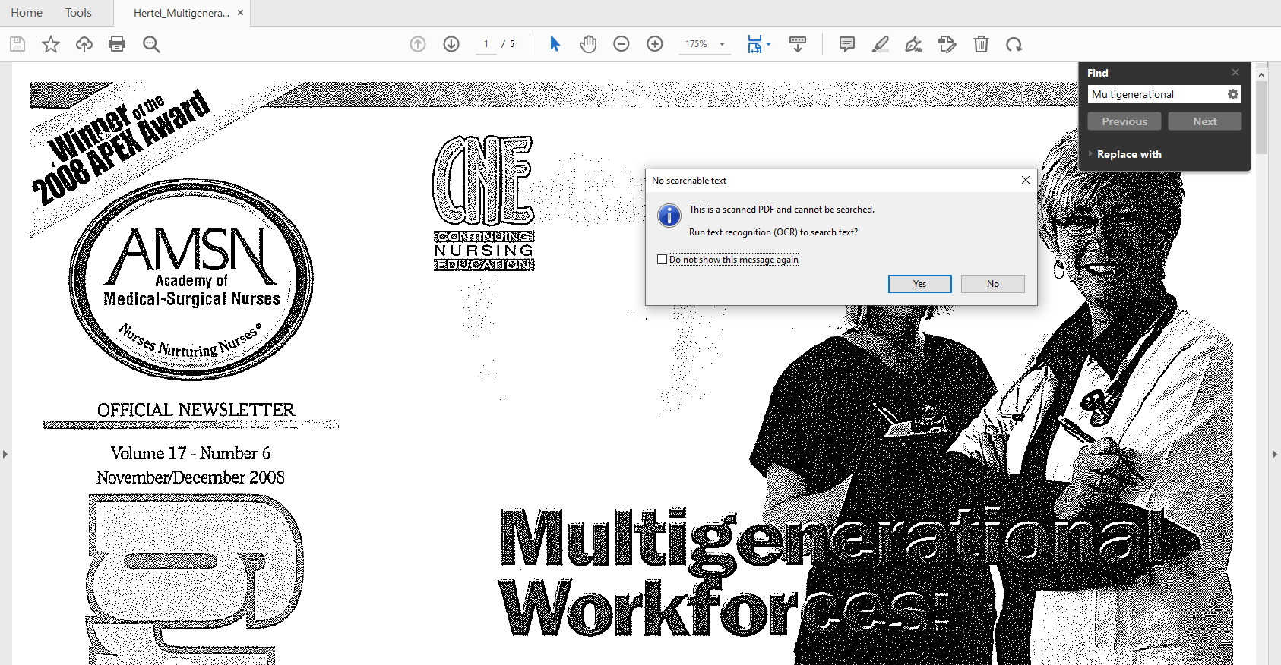
Search on a keyword or try to select text within a PDF to check
Notes:
You can check to see if the PDF has been tagged by opening the document in Adobe Reader and going under the File menu, selecting Properties. In the Document Properties pop-up window, look for the word “Yes” next to Tagged PDF at the bottom of the screen. Please be aware, that even though a document may have tags, they may not be semantically correct. Problems arise with automatic tagging that produce the wrong tags, or wrong parenting order and break the meaning that is conveyed visually. A common problem with automatic tagging is the breaking up of one list into multiple lists. Another is the addition of empty tags produced by spaces created by using the return key multiple times within a Word document, before it was converted to PDF.
To see if a document has searchable text, you can also check it within Adobe Reader by pressing your CTRL key plus “F.” Then in the “Find” search box that pops up, type a word that you see in the PDF and click the “Next” button. If the word becomes highlighted on the page, then it has searchable text as opposed to being a scanned image of text. (in Acrobat Pro, use the magnifier glass button, for Find Text, to open the Find floating window.)
You can check for correct read order within an accessible, tagged PDF or one that has had optical character recognition done on it by going under the "View" menu and checking off "Read Mode." You then go under the "View" menu, select "Read Out Loud," and "Activate Read Out Loud." Go back under the "View" menu and select "Read Out Loud," and either "Read This Page Only," or "Read To End Of Document." Listen to see if the order of presentation makes sense for meaning. Pay attention to areas where diagrams with text have been inserted into pages. The text within these gets converted to searchable text that can be read, but often they get read in the middle of something else, breaking logical read order.
Often, you will find "full text PDF" versions of publisher's articles on library databases. These articles have had optical character recognition run on them, and have searchable text, but don't necessarily have correct read order, especially when figures or tables are inserted within the body of the text, or there are multi-column layouts. These are partially accessible, but better than a scanned image of an article.

Slide 24
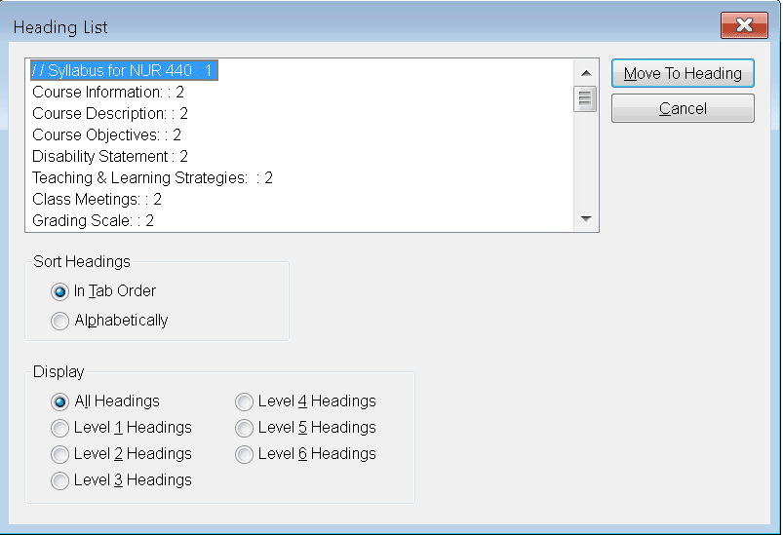
SRS 8.3 Text Accessibility - 2
Use Heading Styles.
Use heading styles to communicate hierarchy of content in a web page or document. Screen readers use keyboard combinations to bring up a list of headings on a web page to facilitate navigation.
JAWS: Insert + F6
Notes:
Correct hierarchical application of Word heading styles or HTML tags makes it easy to generate a Table of Contents in Word, and for people who are blind and using a screen reader, to pull up a list of headings and navigate to where they need to go. Don’t just make font bold or larger size to present a heading in a document. This may speak to someone who has their vision, but it doesn’t tell assistive technology that some thing is a heading. Always use styles in the Styles pane for headings, or normal body text. Strong style for emphasized text. With JAWS, Insert + F6 brings up a context list of headings on the page. People who use a screen reader can jump to a specific heading to facilitate navigation.

Slide 25
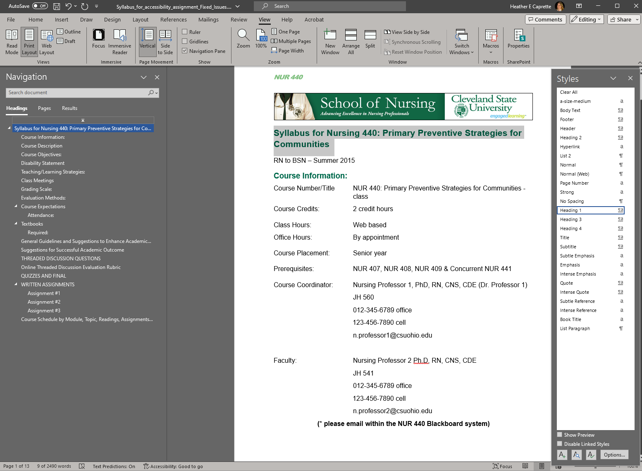
Example of Syllabus with Heading 1, Heading 2, and Heading 3 applied. Headings appear in the Navigation pane on the left.
Notes:
When you open the Navigation pane in Word, from the View Ribbon, you can see the hierarchy of Word Heading Styles applied to this syllabus document, indicated by indentation. Heading 1 will be to the far left. Heading 2, is indented slightly to the right. Heading 3 text is further indented to the right, under their corresponding Heading 2 style. To apply a Word Heading Style, select text that you want to be a heading, then click the Heading style from the Styles pane on the right. Some styles also appear on the Home ribbon at the top. Heading Styles can be modified by the course developer by right clicking on the Heading # and selecting Modify. Important: Don’t skip heading levels! Right click and modify the style of a Heading if you need to.

Slide 26
SRS 8.3 Text Accessibility - 3
Color alone should not convey meaning, can add “Important:,” “Note:,” or “*” before/beside important information.
Create simple tables out of text, with one header row or one header column. No merged /split cells.
Provide context for a table with a caption, alt text, and long description.
Notes:
Screen readers can be set to read heading cell text before a data cell text for a person who is blind to understand the relationship of the information in the table.

Slide 27
Example of adding meaning through another means than color alone
Week | Date | Topic
1 | January 17 | Orientation to Blackboard Learn
1 | January 19 | APA Style Manual
2 | * January 24 | Exploring CSU Library Resources Online, Literature Services
2 | January 26 | Refreshing Writing Skills
3 | * January 31 | Using Images and Media
3 | February 2 | Presenting a Professional Image
4 | February 7 | Public Appearances
4 | * February 9 | Communication in the Health Care Setting
5 | February 14 | Resolving Conflicts
If you want to indicate the dates on which students will have an exam, don’t just put those dates in red, but indicate they have an asterisk beside them and bold font.
Notes:
Add an asterisk, and or bolding to make certain text/dates, etc. stand out.

Slide 28
SRS 8.4 Image Accessibility - 1
Images in the course are accessible.
Meaningful, functional images have alt text
Always check A.I. generated alt text!
Use captions to describe complex images like diagrams
If long descriptions needed, provide a descriptive text link to the location where the long description is or describe in body text
Notes:
Always check AI generated alt text for images.

Slide 29
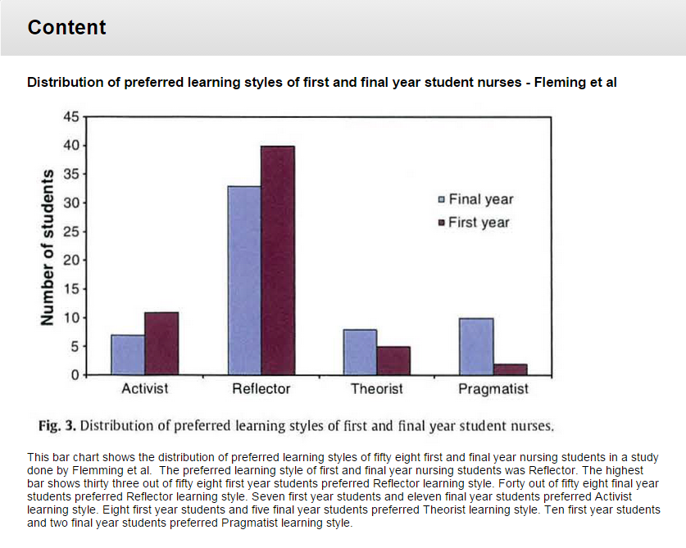
Bar chart with explanatory description below it. Note: The Diagram Center’s website has examples of the ways that complex charts and graphics can be explained with alternative text, simple tables and lists.
Notes:
Example of a bar chart image from Blackboard Learn Original. It has a descriptive title above it, and an explanation just underneath it that explains the important points in the graph. If you need to put a longer description of an image within an Appendix in Word, create a bookmark to it and link to the bookmark within the caption description under the image. The Diagram Center’s website has examples of the ways that complex charts and graphics can be explained with alternative text, simple tables and lists. See https://www.diagramcenter.org

Slide 30
SRS 8.4 Image Accessibility - 2
Decorative images that don’t convey meaning for the learning experience, such as a flourish or graphic horizontal rule, should have the Null Alt Attribute, alt=“”, assigned to it. <img src=“images/flourish.png” alt=“”>
Check “Mark as decorative” box and write “Decorative” in Microsoft Office Alt Text field.
Notes:
Older screen readers may not detect if a MS Office image is marked with the decorative box. Some accessibility testing and training companies recommend writing “decorative” in the alt text field to make sure the screen reader user understands that the image doesn’t convey meaning and is decorative.

Slide 31
SRS 8.5 Video and Audio Content -1
Video and audio content in the course is accessible.
Video should have synchronized, accurate captions. Capitalization and punctuation should be present.
Audio only should have a transcript.
Notes:
Correct hierarchical application of Word heading styles or HTML tags makes it easy to generate a Table of Contents in Word, and for people who are blind and using a screen reader, to pull up a list of headings and navigate to where they need to go. See References ribbon in Word > Table of Contents. Don’t just make font bold or larger size to present a heading in a document. This may speak to someone who has their vision, but it doesn’t tell assistive technology that some thing is a heading.

Slide 32
SRS 8.5 Video and Audio Content -2
Identify speakers if more than one:
"Joe: I hate this computer! [shouted]“
“Librarian: Shh! [holding his finger to his lips]”
Important information in the video that is not spoken should have audio description. If a procedure, could have a transcript of steps.
Notes:
Example that may need audio description could be a video tutorial of a laboratory experiment.

Slide 33
SRS 8.6 Multimedia - 1
Multimedia in the course should be easy to use.
Players allow for pause, forward, rewind, resize, captions
Content should resize without loss of detail
Long video should be broken into segments no more than 20 minutes
Provide bookmarks where possible
Notes:
Most players that higher ed uses today have this functionality. Panopto, used at CSU, will allow the user to edit an auto-generated Table of Contents based on slide titles, for slides that appear on screen for 5 seconds or longer. OCR is involved in videos where PowerPoint presentations aren’t used.

Slide 34
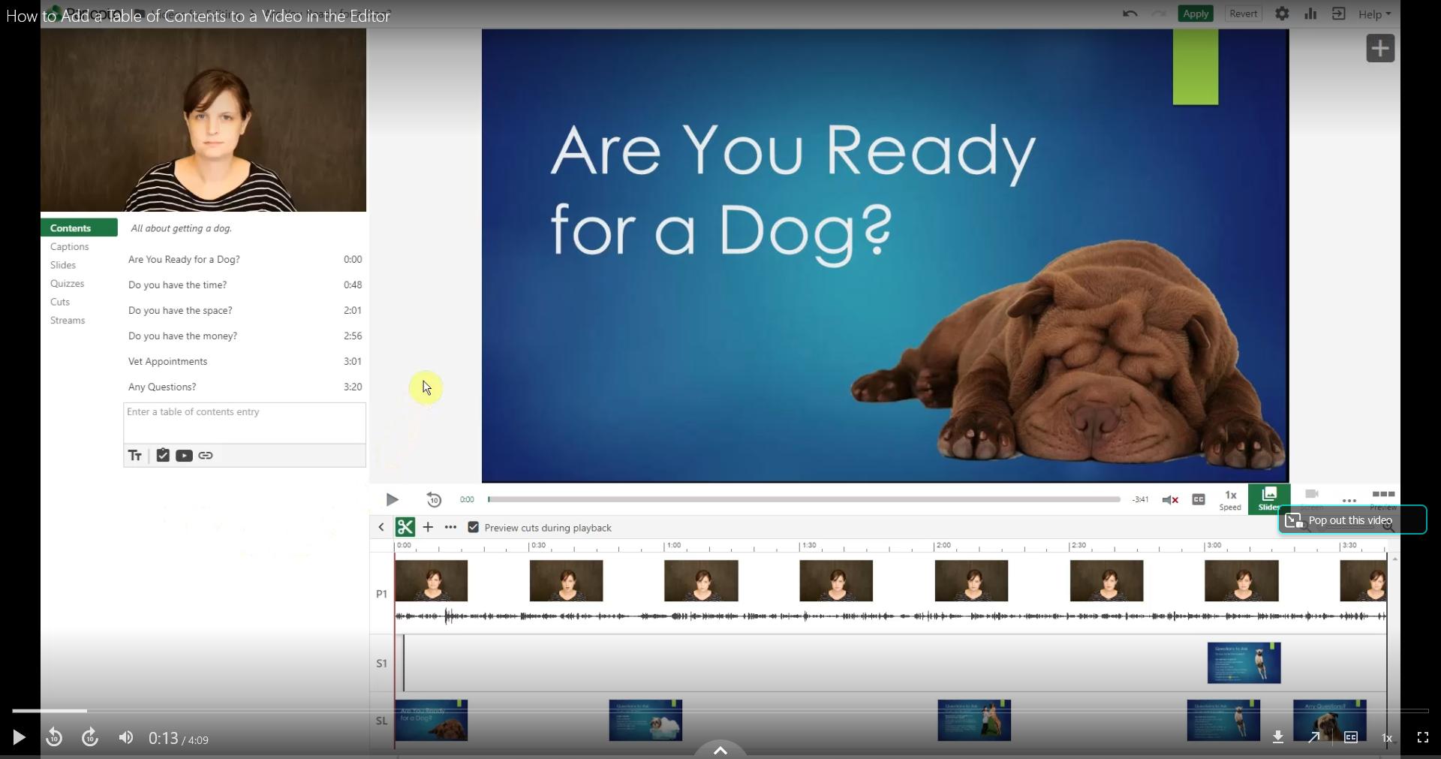
Panopto allows for editing a Table of Contents, (and editing ASR captions). It’s player controls allow for pause, rewind, fast forward, adjustment of playback speed. It responds to browser window resizing.
Notes:
Panopto player facilitates ease of use for recorded lectures in online courses. It also allows for the creation of a Table of Contents that students can use to jump to a specific point in the video that discusses that sub-topic.

Slide 35
SRS 8.7 Vender Accessibility Statements
Vendor accessibility statements are provided for the technologies used in the course.
Link to web pages where vender explains the accessibility of their product. Could include a guide to how to navigate or use their product with a keyboard.
Could include VPAT where available.
Notes:
Voluntary Product Accessibility Templates (VPATS) are reports typically produced by a company that does usability testing that explains how accessible the product is and where there are issues. It can give a heads up to the institution and users of the technology about issues they may encounter.

Slide 36
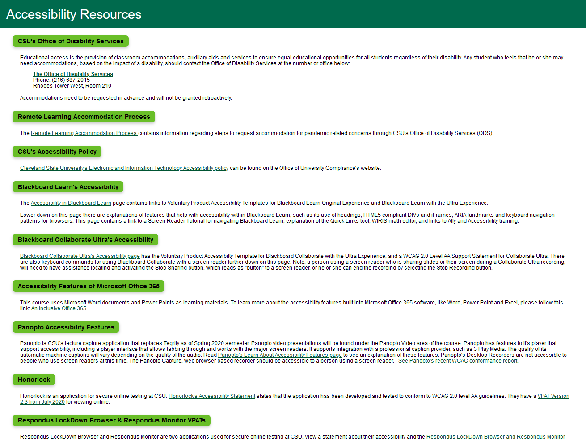
Accessibility Resources page from our CSU Course Template
Notes:
I used a web page in Blackboard’s Content Collection to create a list of accessibility resources for students. It resides in our CSU Course Template. It has links to our Office of Disability Services and information on how to obtain accommodation, if you need these services. There’s a link to CSU’s accessibility policy, as well as links to Accessibility Statements, and web pages explain the accessibility of the technology we commonly use in online courses at CSU.

Slide 37
Additional Resources
WebAIM.org - Institute for Disability Research, Policy, and Practice at Utah State University
WAVE – Web Accessibility Evaluation Tool – https://wave.webaim.org
Colour Contrast Analyser - https://www.tpgi.com/color-contrast-checker/
Coblis Coor-blind Simulator - https://www.color-blindness.com/coblis-color-blindness-simulator/
Make Your Content Accessible in the Microsoft 365 Apps - https://support.microsoft.com/en-us/office/make-your-content-accessible-in-the-microsoft-365-apps-8a04499b-8a58-4db6-8c9d-5837f60745ef
Microsoft Word Accessibility Techniques - https://support.microsoft.com/en-us/office/make-your-word-documents-accessible-to-people-with-disabilities-d9bf3683-87ac-47ea-b91a-78dcacb3c66d
Microsoft Office Accessibility Checker - https://support.microsoft.com/en-us/office/improve-accessibility-with-the-accessibility-checker-a16f6de0-2f39-4a2b-8bd8-5ad801426c7f
Notes:
Freely available references on how to format for accessibility and evaluate accessibility of web pages, documents, images, audio and video.

Slide 38
Additional Resources continued
Adobe’s PDF Accessibility Overview - https://www.adobe.com/accessibility/pdf/pdf-accessibility-overview.html
Amara.org – Amara free, public way to add captions to a video someone else owns on YouTube or Vimeo
Add Subtitles & Captions to YouTube Videos – for videos you own and upload to YouTube
Tips for writing transcripts - http://www.uiaccess.com/transcripts/transcripts_on_the_web.html
Audio Descriptions - At a Glance – YouTube explanation - https://youtu.be/y89reMUP1Jk?si=TNtp0t1F0caDZsYK
Web Accessibility Initiative’s Design & Develop - https://www.w3.org/WAI/design-develop/
The Diagram Center - http://diagramcenter.org/
Notes:
Freely available references on how to format for accessibility and evaluate accessibility of web pages, documents, images, audio and video.

Slide 39
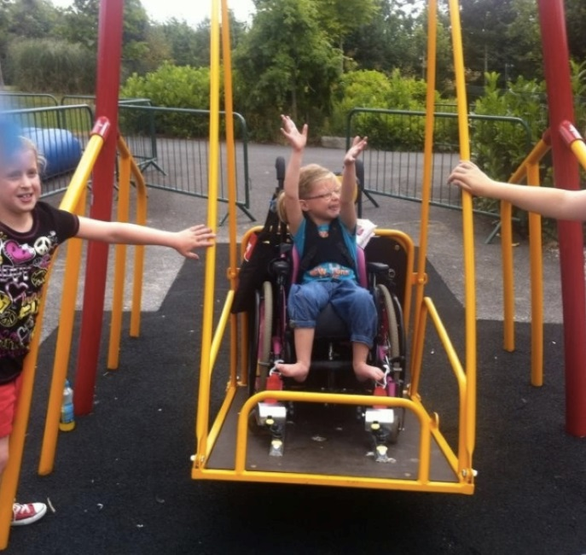
Build an Enjoyable Experience!
Contact Information:
Heather Caprette, M.F.A. Cleveland State University h.caprette@csuohio.edu
(216) 802-3142
Photo Credit: Caoimhe Ross enjoying swing at Tayto Park, Ireland by Chompsky, 2013, source:
http://www.broadsheet.ie/2013/07/26/fair-play-though-in-fairness-43/

