Slide 1
How To Build An Assessment And Impact Model
Dr. Suzan Harkness
Quality Matters Regional Conference
April 2017
Berkeley College, New York City

Slide 2
OBJECTIVES
Define and identify the locations of data that are necessary in constructing an assessment validation model.
Recognize and discuss potential barriers to access and collaborative modelling.
Outline a partner/collaborative construct to begin thinking about how you might take this approach to your home campus.

Slide 3
PLANNED INTERACTIONS
There will be a brief discussion of a successful model, identification of collaborative campus partners and data sources.
A contributive conversation will engage participants to explore barriers and locations of data sources on respective campuses.
Participants will be asked to outline a campus collaborative construct to gather and measure success on their respective campus with the help and input of others.

Slide 4
Strategic initiative spanned a period of five academic years (2010–2014)
Involved 600–700 online learners each semester and 2,600 students across five years
Students exhibited an average 19.7 percent increase in passing course grades (A-D)
66.6 percent reduction in failing course grades (F)
23.5 percent reduction in course withdrawal over a five-year period (pre-/post-Quality Matters course-design interventions).

Slide 5
SUCCESS WAS DUE TO A CONFLUENCE OF FACTORS
An early assessment of baseline data; gap analysis of faculty and student need;
A data-driven approach that included careful planning, rich cultivation of data and establishing a data warehouse;
Assessment of faculty technology use and training required;
A content analysis of how the LMS was used to promote rich learning;
Implementation of a robust professional development strategy;
The development of new policies and procedures;
An in-house teaching certification process driven by faculty and administration collaboration; and
Strong partnerships to benchmark and support the online program.

Slide 6
Each institution will need to take an approach that is relevant to its own culture
Administrators pay attention to data and results that are backed by hard numbers
There is no such thing as perfect data
It is important to have the data easily accessible via a single data repository – data warehouse
It is important to be able to leverage data at all levels of the institution through strong communication strategies—that is, tell your story and tell it often

Slide 7
PUTTING THE PIECES TOGETHER TO BUILD A VALIDATION MODEL
Collection & Assessment
QM Standards
Budget
Policies
Faculty Readiness
Student Readiness
Infrastructure
Student
Data
Baseline Assessment
Institutional Data
Administrative Support
Collaboration
Faculty Data
Tools

Slide 8
Survey Collected 206 Complete Responses Survey sent to 1,500 QMCs

Slide 9
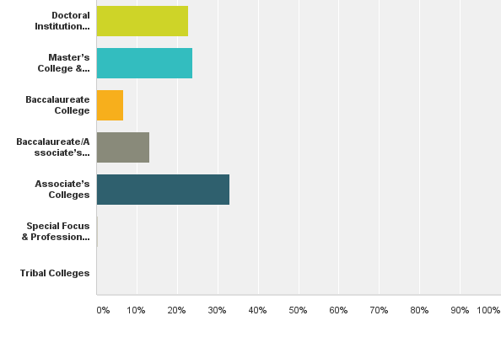
TYPE OF INSTITUTION (CARNEGIE 2015 CLASSIFICATION)
Answered: 197 Skipped: 9
22.84 (n=45)
23.86 (n=47)
6.60 (n=13)
13.20 (n=26)
32.99 (n=65)
0.51 (n=1)
0 (n=0)

Slide 10
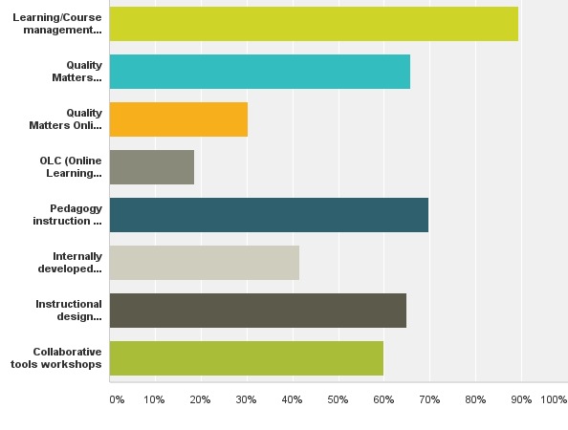
WHAT ON-CAMPUS PROFESSIONAL DEVELOPMENT OPPORTUNITIES ARE OFFERED?
Answered: 205 Skipped: 1
89.27 (n=183)
65.85 (n=135)
30.24 (n=62)
18.54 (n=38)
69.76 (n=143)
42.46 (n=85)
64.88(n=133)
60.00 (n=123)

Slide 11
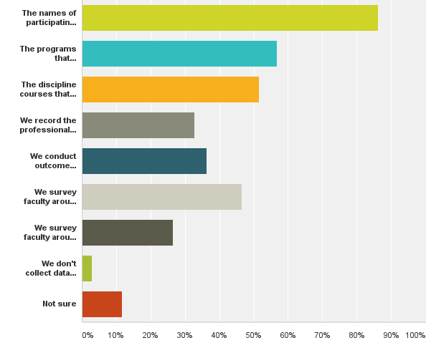
WHAT DATA REGARDING FACULTY PARTICIPATION IS COLLECTED?
Answered: 204 Skipped: 2
86.27 (n=176)
56.86 (n=116)
51.47 (n=105)
32.84 (n=67)
36.27 (n=74)
46.57 (n=95)
26.47 (n=54)
2.94 (n=6)
11.76 (n=24)

Slide 12
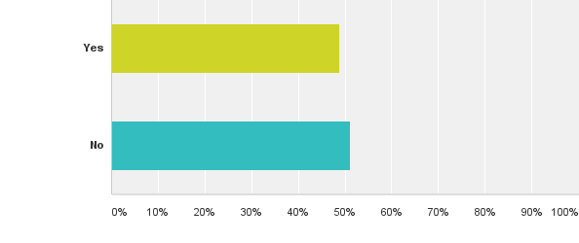
DO YOU RUN DATA ANALYTICS ON HOW THE C/LMS IS USED BY FACULTY?
Answered: 205 Skipped: 1
48.76 (n=100)
51.22 (n=105)

Slide 13
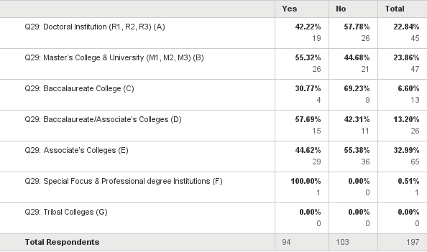
DO YOU KNOW HOW YOUR LEARNING/COURSE MANAGEMENT SYSTEM IS USED BY FACULTY?
Answered: 197 Skipped: 0

Slide 14
HOW OFTEN DO YOU PERFORM THESE DATA ANALYTICS?
Answered: 78 Skipped: 128

Slide 15
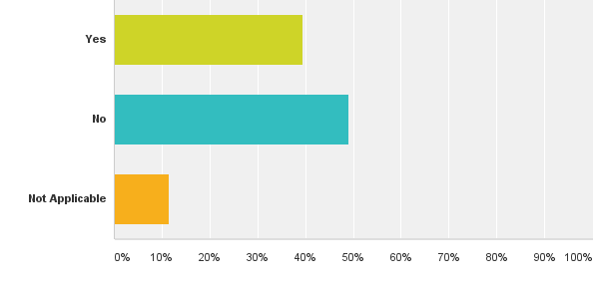
DO YOU TRACK FACULTY ENGAGEMENT IN ON-CAMPUS PROFESSIONAL DEVELOPMENT AND TAILOR TRAINING?
Answered: 200 Skipped: 6
39.50 (n=79)
49.00 (n=98)
11.50 (n=23)

Slide 16
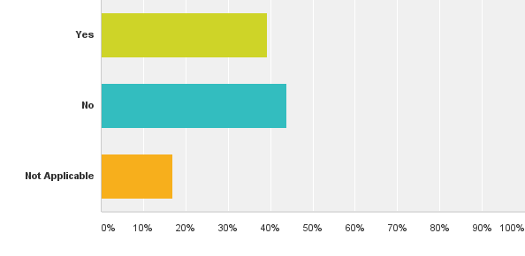
DO YOU TRACK FACULTY WHO ENGAGE IN OFF CAMPUS SPONSORED PROFESSIONAL DEVELOPMENT?
Answered: 201 Skipped: 5
39.30 (n=79)
43.78 (n=88)
16.92 (n=34)

Slide 17
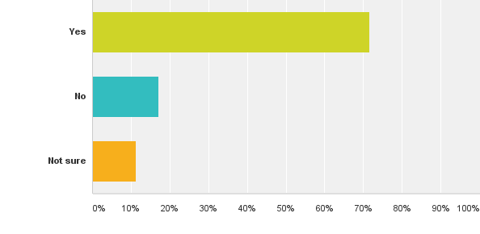
DO YOU PAY FOR OFF CAMPUS PROFESSIONAL DEVELOPMENT?
Answered: 204 Skipped: 2
71.57 (n=146)
17.16 (n=35)
11.27 (n=23)

Slide 18
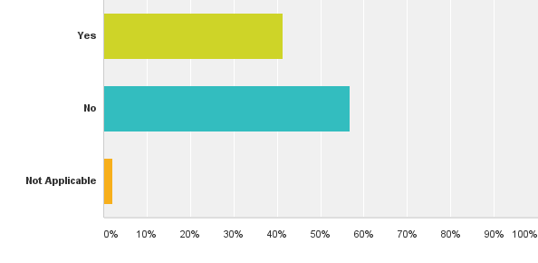
DO YOUR REQUIRE FACULTY CERTIFICATION TO TEACH ONLINE?
Answered: 201 Skipped: 5
41.29 (n=83)
56.72 (n=114)
1.99 (n=4)

Slide 19
DO YOU OFFER ON-CAMPUS CERTIFICATION TO TEACH ONLINE?
Answered: 204 Skipped: 2
49.02 (n=100)
50.98 (n=104)

Slide 20
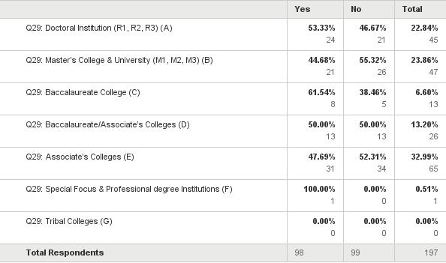
ON CAMPUS CERTIFICATION OFFERED ON CAMPUS BY CLASSIFICATION

Slide 21
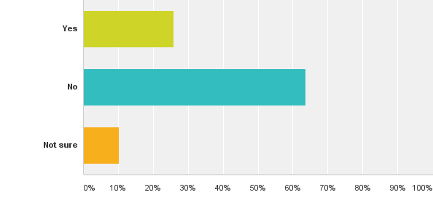
DO YOU REQUIRE STUDENTS TO TAKE SOME FORM OF ONLINE LEARNING READINESS?
Answered: 204 Skipped: 2
25.98 (n=53)
63.73 (n=130)
10.29 (n=21)

Slide 22
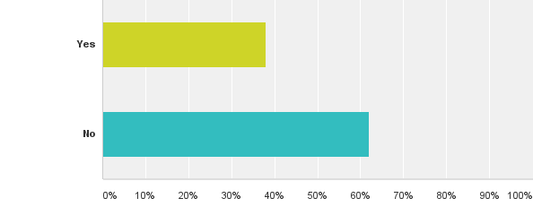
DO YOU WRITE ANNUAL REPORTS ON FACULTY PROFESSIONAL DEVELOPMENT?
Answered: 203 Skipped: 3
37.93 (n=77)
62.07 (n=126)

Slide 23
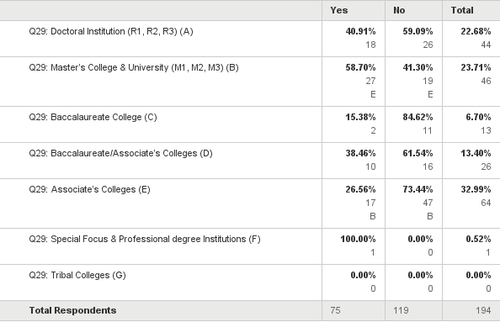
REPORT WRITING BY INSTITUTIONAL CLASSIFICATION

Slide 24
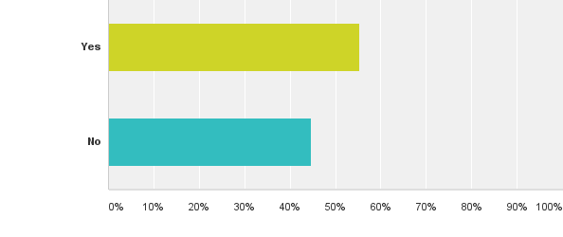
DOES YOUR INSTITUTION USE AN EVALUATION OF COURSES PRIOR TO GOING LIVE?
Answered: 201 Skipped: 5
55.22 (n=111)
44.78 (n=90)

Slide 25
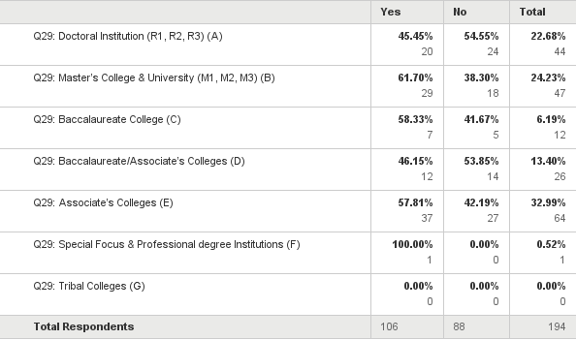
COURSE REVIEW PRIOR TO GOING LIVE BY INSTITUTIONAL CLASSIFICATION

Slide 26
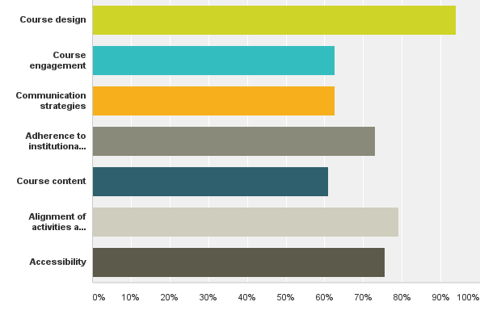
WHAT COMPONENTS OF COURSES ARE EVALUATED?
Answered: 115 Skipped: 91
93.91 (n=108)
62.61 (n=72)
62.61 (n=72)
73.04 (n=84)
60.87 (n=70)
79.13 (n=91)
75.65 (n=87)

Slide 27
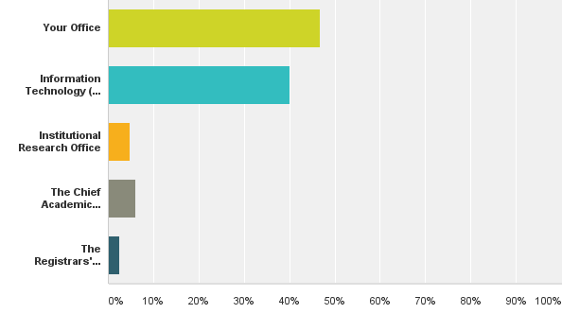
WHO KEEPS LEARNING/COURSE MANAGEMENT DATA?
Answered: 165 Skipped: 41
46.67 (n=77)
40.00 (n=66)
4.85 (n=8)
6.06 (n=10)
2.42 (n=4)

Slide 28
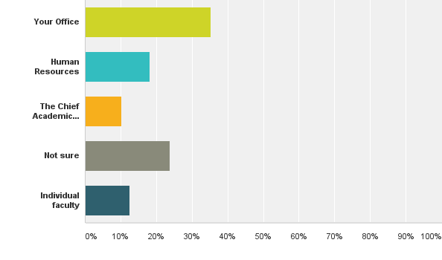
WHO KEEPS FACULTY PROFESSIONAL DEVELOPMENT RECORDS?
Answered: 176 Skipped: 30
35.23 (n=62)
18.18 (n=32)
10.23 (n=18)
23.86 (n=42)
12.50 (n=22)

Slide 29
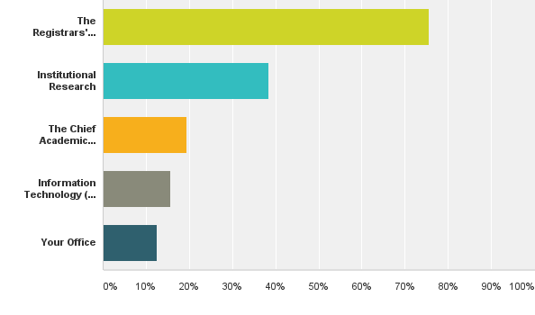
WHO KEEPS STUDENT ONLINE LEARNING RECORDS?
Answered: 185 Skipped: 21
75.68 (n=140)
38.38 (n=71)
19.46 (n=36)
15.68 (n=29)
12.43 (n=23)

Slide 30
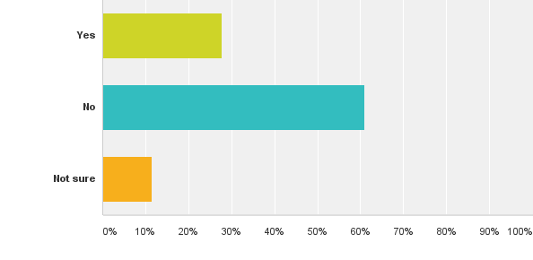
DO YOU HAVE ACCESS TO STUDENT TRANSCRIPTS?
Answered: 202 Skipped: 4
27.72 (n=56)
60.89 (n=123)
11.39 (n=23)

Slide 31
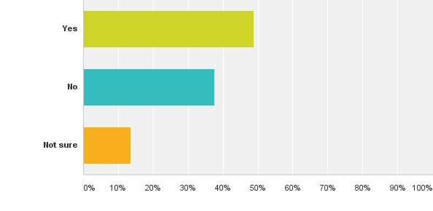
DO YOU HAVE ACCESS TO SUMMATIVE (END OF TERM) COURSE GRADES OF ENROLLED STUDENTS?
Answered: 205 Skipped: 1
48.78 (n=100)
37.56 (n=77)
13.66 (n=28)

Slide 32
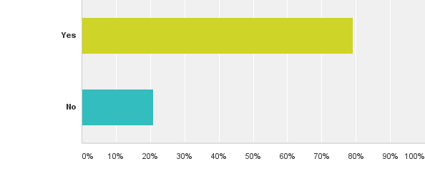
DOES YOUR OFFICE COLLABORATE WELL WITH INFORMATION TECHNOLOGY (IT)?
Answered: 201 Skipped: 5
79.10 (n=159)
20.90 (n=42)

Slide 33
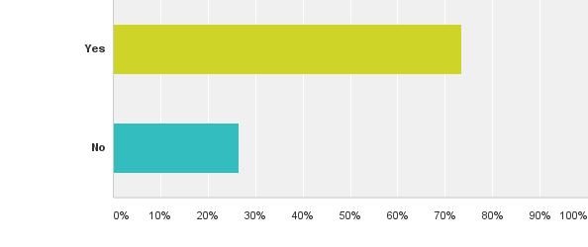
DOES YOUR OFFICE COLLABORATE WELL WITH INSTITUTIONAL RESEARCH?
Answered: 200 Skipped: 6
73.50 (n=147)
26.50 (n=53)

Slide 34
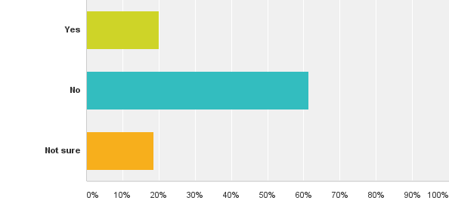
DO YOU HAVE ADEQUATE STAFFING TO MINE DATA AND PERFORM ANALYTICS?
Answered: 204 Skipped: 2
20.10 (n=41)
61.27 (n=125)
18.63 (n=38)

Slide 35
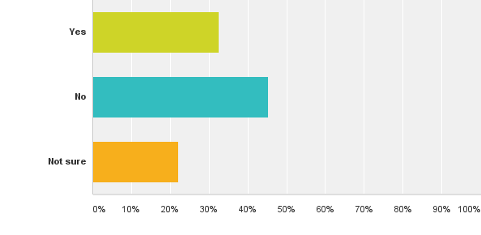
DO YOU HAVE ADEQUATE ANALYTICAL TOOLS TO SUPPORT ANALYTICAL ASSESSMENT?
Answered: 203 Skipped: 3
32.51 (n=66)
45.32 (n=92)
22.17 (n=45)

Slide 36
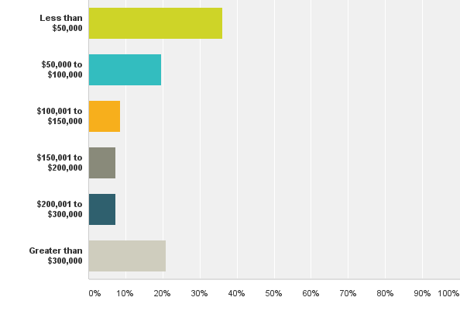
ANNUAL BUDGET, NOT INCLUDING PERSONNEL
Answered: 163 Skipped: 43
36.20 (n=59)
19.63 (n=32)
8.59 (n=14)
7.36 (n=12)
7.36 (n=12)
20.86 (n=34)

Slide 37
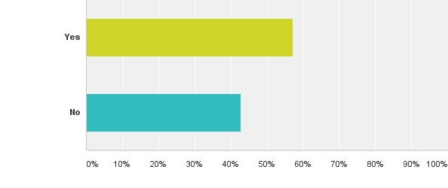
DO YOU FIND THAT YOU HAVE APPROPRIATE SUPPORT FROM THE ADMINISTRATION?
Answered: 187 Skipped: 19
57.22 (n=107)
42.78 (n=80)

Slide 38
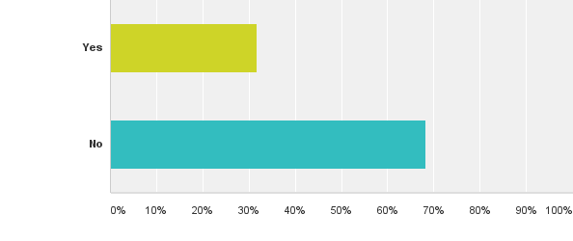
DO YOU USE ANALYTICS OR ASSESSMENTS DATA TO VALIDATE THE IMPACT OF YOUR PROFESSIONAL DEVELOPMENT?
Answered: 186 Skipped: 20
31.72 (n=59)
68.28 (n=127)

Slide 39
What about your institution?... Where do you start?
What do you want to measure?
What inputs are needed?
How do you define impact or success?
What tools, resources, relationships exist?
Who needs to know the outcomes?

