Slide 1
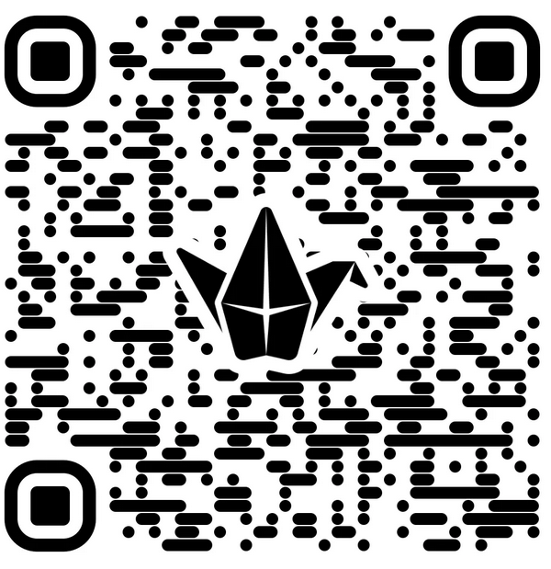
IN THE CHAT: What are your experiences with student peer mentorship?
ON THE PADLET: What are the benefits of peer mentorship?

Slide 2
Peer Mentoring as a Tool for Achieving Outcomes through Active Learning Andria F. Schwegler, Madelynn D. Shell, and Malin K. Lilley

Slide 3
Session Learning Outcomes
Describe an example of implementing peer mentors in an online course
Recognize alignment of the mentoring program and course development with QM Standards
Evaluate data on the impact of a first year of peer mentor program on mentees and mentors
Discuss integrating peer mentors at your institution (benefits, challenges)

Slide 4
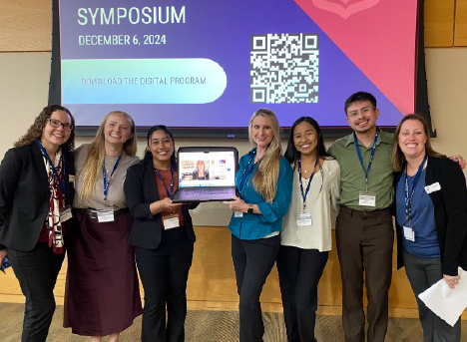
TAMUCT Psychology Program
Program guiding beliefs (Schwegler, Shell, & Clark, 2024)
High impact practices across the curriculum (Linder & Hayes, 2018)
Students
100% transfer (i.e., upper-division only)
Non-traditional
Many need entry-level skills for success
Primarily online (i.e., synchronous and asynchronous courses)

Slide 5
Mentorship and High Impact Practices
“A mutually beneficial relationship between a specified student group (i.e. mentee) and a more experienced student (i.e. mentor) who engages with the mentee in a structured helping capacity to cultivate strong relationships and provide peer-to-peer support.” (https://www.tbr.edu/student-success/hip-taxonomy-peer-mentoring)
Benefits for all! (Newton & Ender 2010; Terrion, & Leonard 2007)
Mentee
Mentor

Slide 6
PSYC 3100 Psychology Major Seminar
Course plan (Moore & Shell, 2022; Shell & Moore, 2025)
Similar to First Year Seminar (High-Impact Educational Practice)
1-credit hour course
Online synchronous delivery
Course design embeds QM Standards that peer mentors model

Slide 7
Course Learning Outcomes
2.1. The course-level learning objectives describe outcomes that are measurable.
CLO1: Read, discuss, and apply core academic skills and soft skills
University resources
Psychology program resources
Careers in psychology
Course planning
Academic skills
Information literacy
Motivation and mindset
Mental health and well-being
CLO2: Engage in professional written and verbal communication
Professionalism
Networking/relationship-building
CLO3: Apply interpersonal and intercultural responsiveness
Cultural responsiveness
Civic engagement

Slide 8
Defining the Peer Mentor Position
Upper-level undergraduate students
Enrolled in Internship course credit
Responsibilities
Attend class sessions
Plan class meetings with faculty
Model class participation (e.g., camera on)
Share experiences as student in program

Slide 9
In-class Activities to Help Learners
Present one slide per class session (warmup or recap)
Host discussions
Demonstrate activities
Ask questions
Moderate chat
5.1 The learning activities help learners achieve the stated objectives.

Slide 10
Opportunities for Interactions
Lead coworking breakout sessions on class topic
Hold one-on-one online meetings with mentees
Set up study groups
1.9 Learners have the opportunity to introduce themselves.
5.2 Learning activities provide opportunities for interactions that support active
learning.

Slide 11
Promoting Resources
Tutoring on course technology or resources (not course content)
Collecting and sharing step-by-step videos
Building a library of support resources (e.g., Canvas page with resources for each topic)
6.1 The tools used in the course support the learning
objectives.
6.2 Course tools promote learner engagement and active
learning.

Slide 12
Faculty-mentor Interactions
Teach separate sections
Review previous class to adjust as needed and plan for future semester
Lesson prep as a team with peer mentors
Collaborative process
Faculty and peer mentors for all sections
Generate new content
Develop engagement strategies to implement in class
Solve problems through collaboration and discussions
5.3 The instructor’s plan for regular interaction with learners in substantive ways during
the course is clearly stated.

Slide 13
Example Lesson and Mentor Role
CLO1: Read, discuss, and apply core academic skills
Module LO: Create a draft of degree plan and course schedule
Before Class
Develop example degree plan
Share with faculty any issues with registration
or scheduling
During Class
Share example of degree plan
Breakout rooms to provide support as students develop their own plans
After Class
Debrief with instructors and how to change for next semester
2.2 The module/unit-level learning objectives describe outcomes that are measurable and consistent with the course-level objectives.

Slide 14
Creating the Peer Mentor Role in the LMS
Peer Mentor role has the following access in Canvas:
View, create, and participate in Discussions (enable permissions)
View-only access to all course content
Ability to use course messaging (Canvas inbox) for individual student communication
No access to student information
No independent course building
No grading
6.2 Course tools promote learner engagement and active
learning.

Slide 15
Effectiveness: Mentee Perspectives
32 students enrolled in three course sections with three different mentors (1-5 point scale)
Prompt | M | SD
Contributed to my learning in class | 4.81 | 0.46
Provided useful personal experiences and knowledge | 4.91 | 0.29
Contributed to class discussions | 4.91 | 0.29
The one on one meetings were beneficial | 4.74 | 0.51
Promoted an environment that was helpful to learning | 4.84 | 0.36
Was easily accessible and helpful when needed | 4.84 | 0.36
Contributed to instructional learning strategies in the course | 4.88 | 0.33

Slide 16
Mentee Comments – Initial Coding
Emerging Themes – Mentor Helped Your Learning Experience?
Triggered positive affect, n = 8 comments
Comfort, motivation, support
Shared personal experiences, n = 17
Answered questions, stimulated discussion, related as a student
Provided academic support, n = 7
Tutorial tools, tips for courses, course content
Provided advising support, n = 13
Course planning, program expectations

Slide 17
Mentee Comments – Initial Coding
Emerging Themes – Other Ways Mentor Could Contribute?
No comments, n = 10
Great job! Nothing more is needed, n = 17
Excellent, no ways to improve, amazing job!
Recommendations, n = 6
Discuss elective courses and student club activities
Share more personal experiences so students don’t feel alone
More 1:1 meetings
Add mentors to other courses to help with content

Slide 18
Mentee Comments – Initial Coding
Emerging Themes – Other Comments about the Mentor Role?
No comments, n = 16
Valuable experience, n = 17
Loved her, motivational, super helpful for learning, great to have
Recommendations, n = 2
Expand mentors to include graduate students
Add mentors to other courses

Slide 19
Effectiveness: Mentor Perspectives
Progress on Program/Discipline Learning Outcomes (Inspired by APA Board of Educational Affairs Task Force on Psychology Major Competencies, 2023)
Professional Values and Ethical Standards
Presentation Skills
Skills, Competencies, and Points of View Needed by Professionals
Interpersonal and Intercultural Responsiveness
Direction for Life after Graduation

Slide 20
Effectiveness: Mentor Perspectives
Mentor Experiences (Inspired by Marshall, Dobbs-Oates, Kunberger, & Greene, 2021)
Growth
Relational Knowledge and Skills
Self-Awareness
Career Identity and Development
Challenges
Learning the Mentor Role
Relating to Students
Student Engagement

Slide 21
Effectiveness: Mentor Perspectives
Group Identification with TAMUCT Psychology Department (Leach, van Zomeren, Zebel, Vliek, Pennekamp, Doosje, Ouwerkerk, & Spears, 2008)
Solidarity
Satisfaction
Centrality
Individual Self-Stereotyping
In-Group Homogeneity

Slide 22
Effectiveness: Group Identification
*
*
*
ϯ p < .10
* p < 05
ϯ
*

Slide 23
Effectiveness: Mentor Perspectives
Too few mentors for quantitative data analysis on other variables
So far, mentors reported high development on
Ability to relate to others, listen, provide feedback
Improved relationship with faculty
Seeing self as a leader and recognizing growth in own educational experiences
Understanding psychology field and own career interests and opportunities

Slide 24
Barriers and Opportunities
Institutional norms
Student resistance to synchronous courses and engagement
Identifying potential mentors
Mentor application process
Faculty evaluation of prospective mentors
Implementing in multiple courses
Lead mentor
Brainstorm and check in on new mentors

Slide 25
Discussion
What are your institutional norms around peer mentorship?
What are other potential barriers?
What other opportunities do you see for a peer mentor program?
Padlet: Benefits of Peer Mentorship

Slide 26
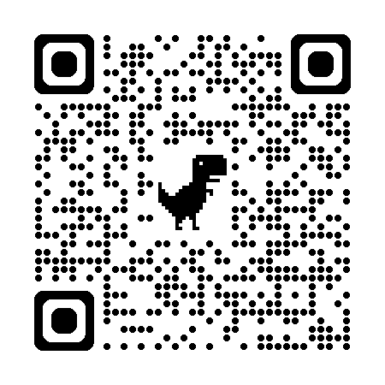
Additional Resources
Questions or comments?
mshell@tamuct.edu
malin.lilley@tamuct.edu
schwegler@tamuct.edu

