Slide 1
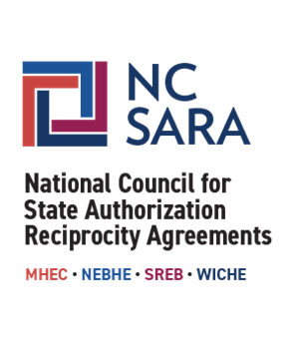
An Introduction to SARA:
Institutional Cost Savings & Benefits to Students
Quality Matters Conference
October 2020

Slide 2

Description
This session will introduce participants to State Authorization Reciprocity Agreements (SARA) and its benefits to students and institutions, and will share some of the preliminary findings on projected institutional savings.
Learning Objectives
Learn about NC-SARA's mission and history in order to share it with others
Describe how SARA reduces institutional state authorization costs
Appreciate SARA's benefits to students through its student consumer protection policies
AGENDA

Slide 3
PRESENTERS
Marianne Boeke, Senior Director for Research & State Support, NC-SARA
Melanie Booth, Director of Educational Programs and Communications, NC-SARA
Tyson Heath, Senior Manager for Academic Engagement, University Compliance, and Title IX, Western Governors University

Slide 4
HISTORY & MISSION

Slide 5
The National Council for State Authorization Reciprocity Agreements, in collaboration with the four regional higher education compacts, was established to develop and implement an effective and efficient reciprocal state-level authorization process for postsecondary distance education.
Its mission is to provide broad access to postsecondary education opportunities to students across the country, to increase the quality and value of higher learning credentials earned via distance education, and to assure students are well served in a rapidly changing education landscape.
Mission

Slide 6
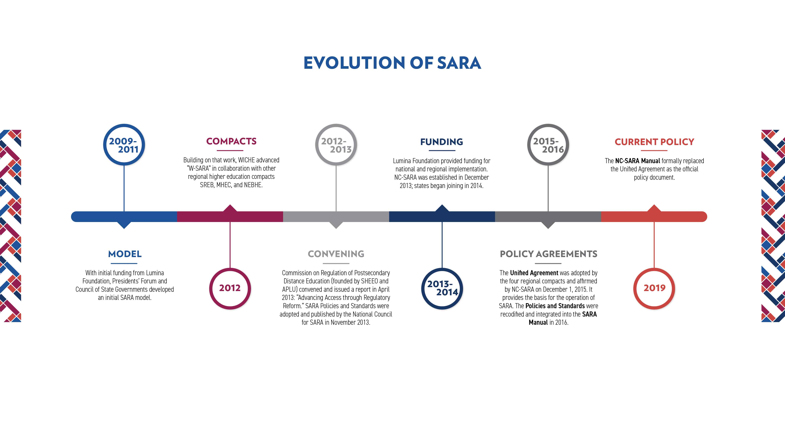

Slide 7
Partners Who Execute The Agreement
SARA Member States
State Education Agencies known as the “State Portal Entity” (SPE)
Regulatory body for institutional participation
Regional Education Compact Organizations
Admit and oversee States that are agreement members
Constitute and oversee a Regional Steering Committee
Operational partner working between the SPE and the national coordinating body of the agreement
National Council for State Authorization Reciprocity Agreements (NC-SARA)
Operates per its own National Board and bylaws as a 501(C)3
Oversees the policy and processes vital to the implementation of the agreement

Slide 8
State Authorization Reciprocity Agreements (SARA)

Slide 9

STATES: HAVE OVERSITE ROLE
Regardless of modality:
States have the authority to regulate institutions offering education within the state's boundaries.
The approval process is part of consumer protection for learners in the state.

Slide 10
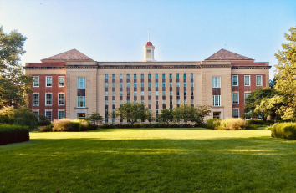
INSTITUTIONS
Institutions must follow the state laws of the state where an institution’s activity takes place.

Slide 11
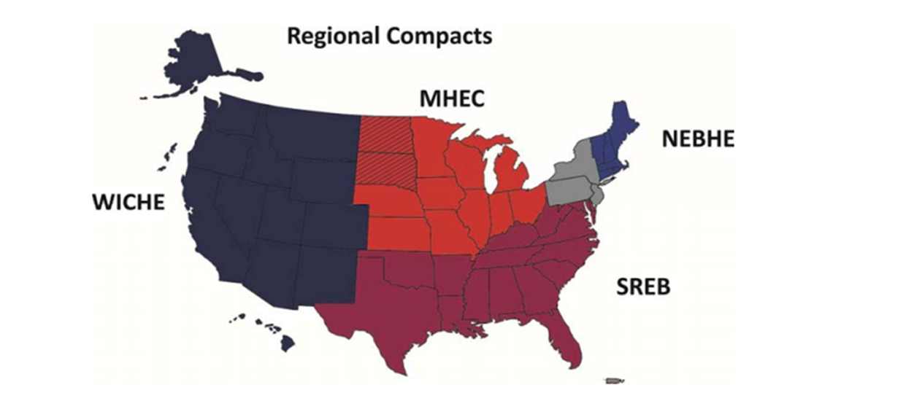
The
SARA Solution
A nation-wide system of reciprocity administered by NC-SARA and the four existing regional compacts.

Slide 12

The current state authorization process was inefficient, costly, and not effective in supporting access to high quality distance education.
The State Authorization Reciprocity Agreements: SARA
SARA provides a streamlined, reciprocity based process for participating postsecondary institutions to gain approval to offer interstate distance education in SARA member states without individually applying
to each state for such approval, subject to certain limitations.
SARA Streamlines Approvals

Slide 13
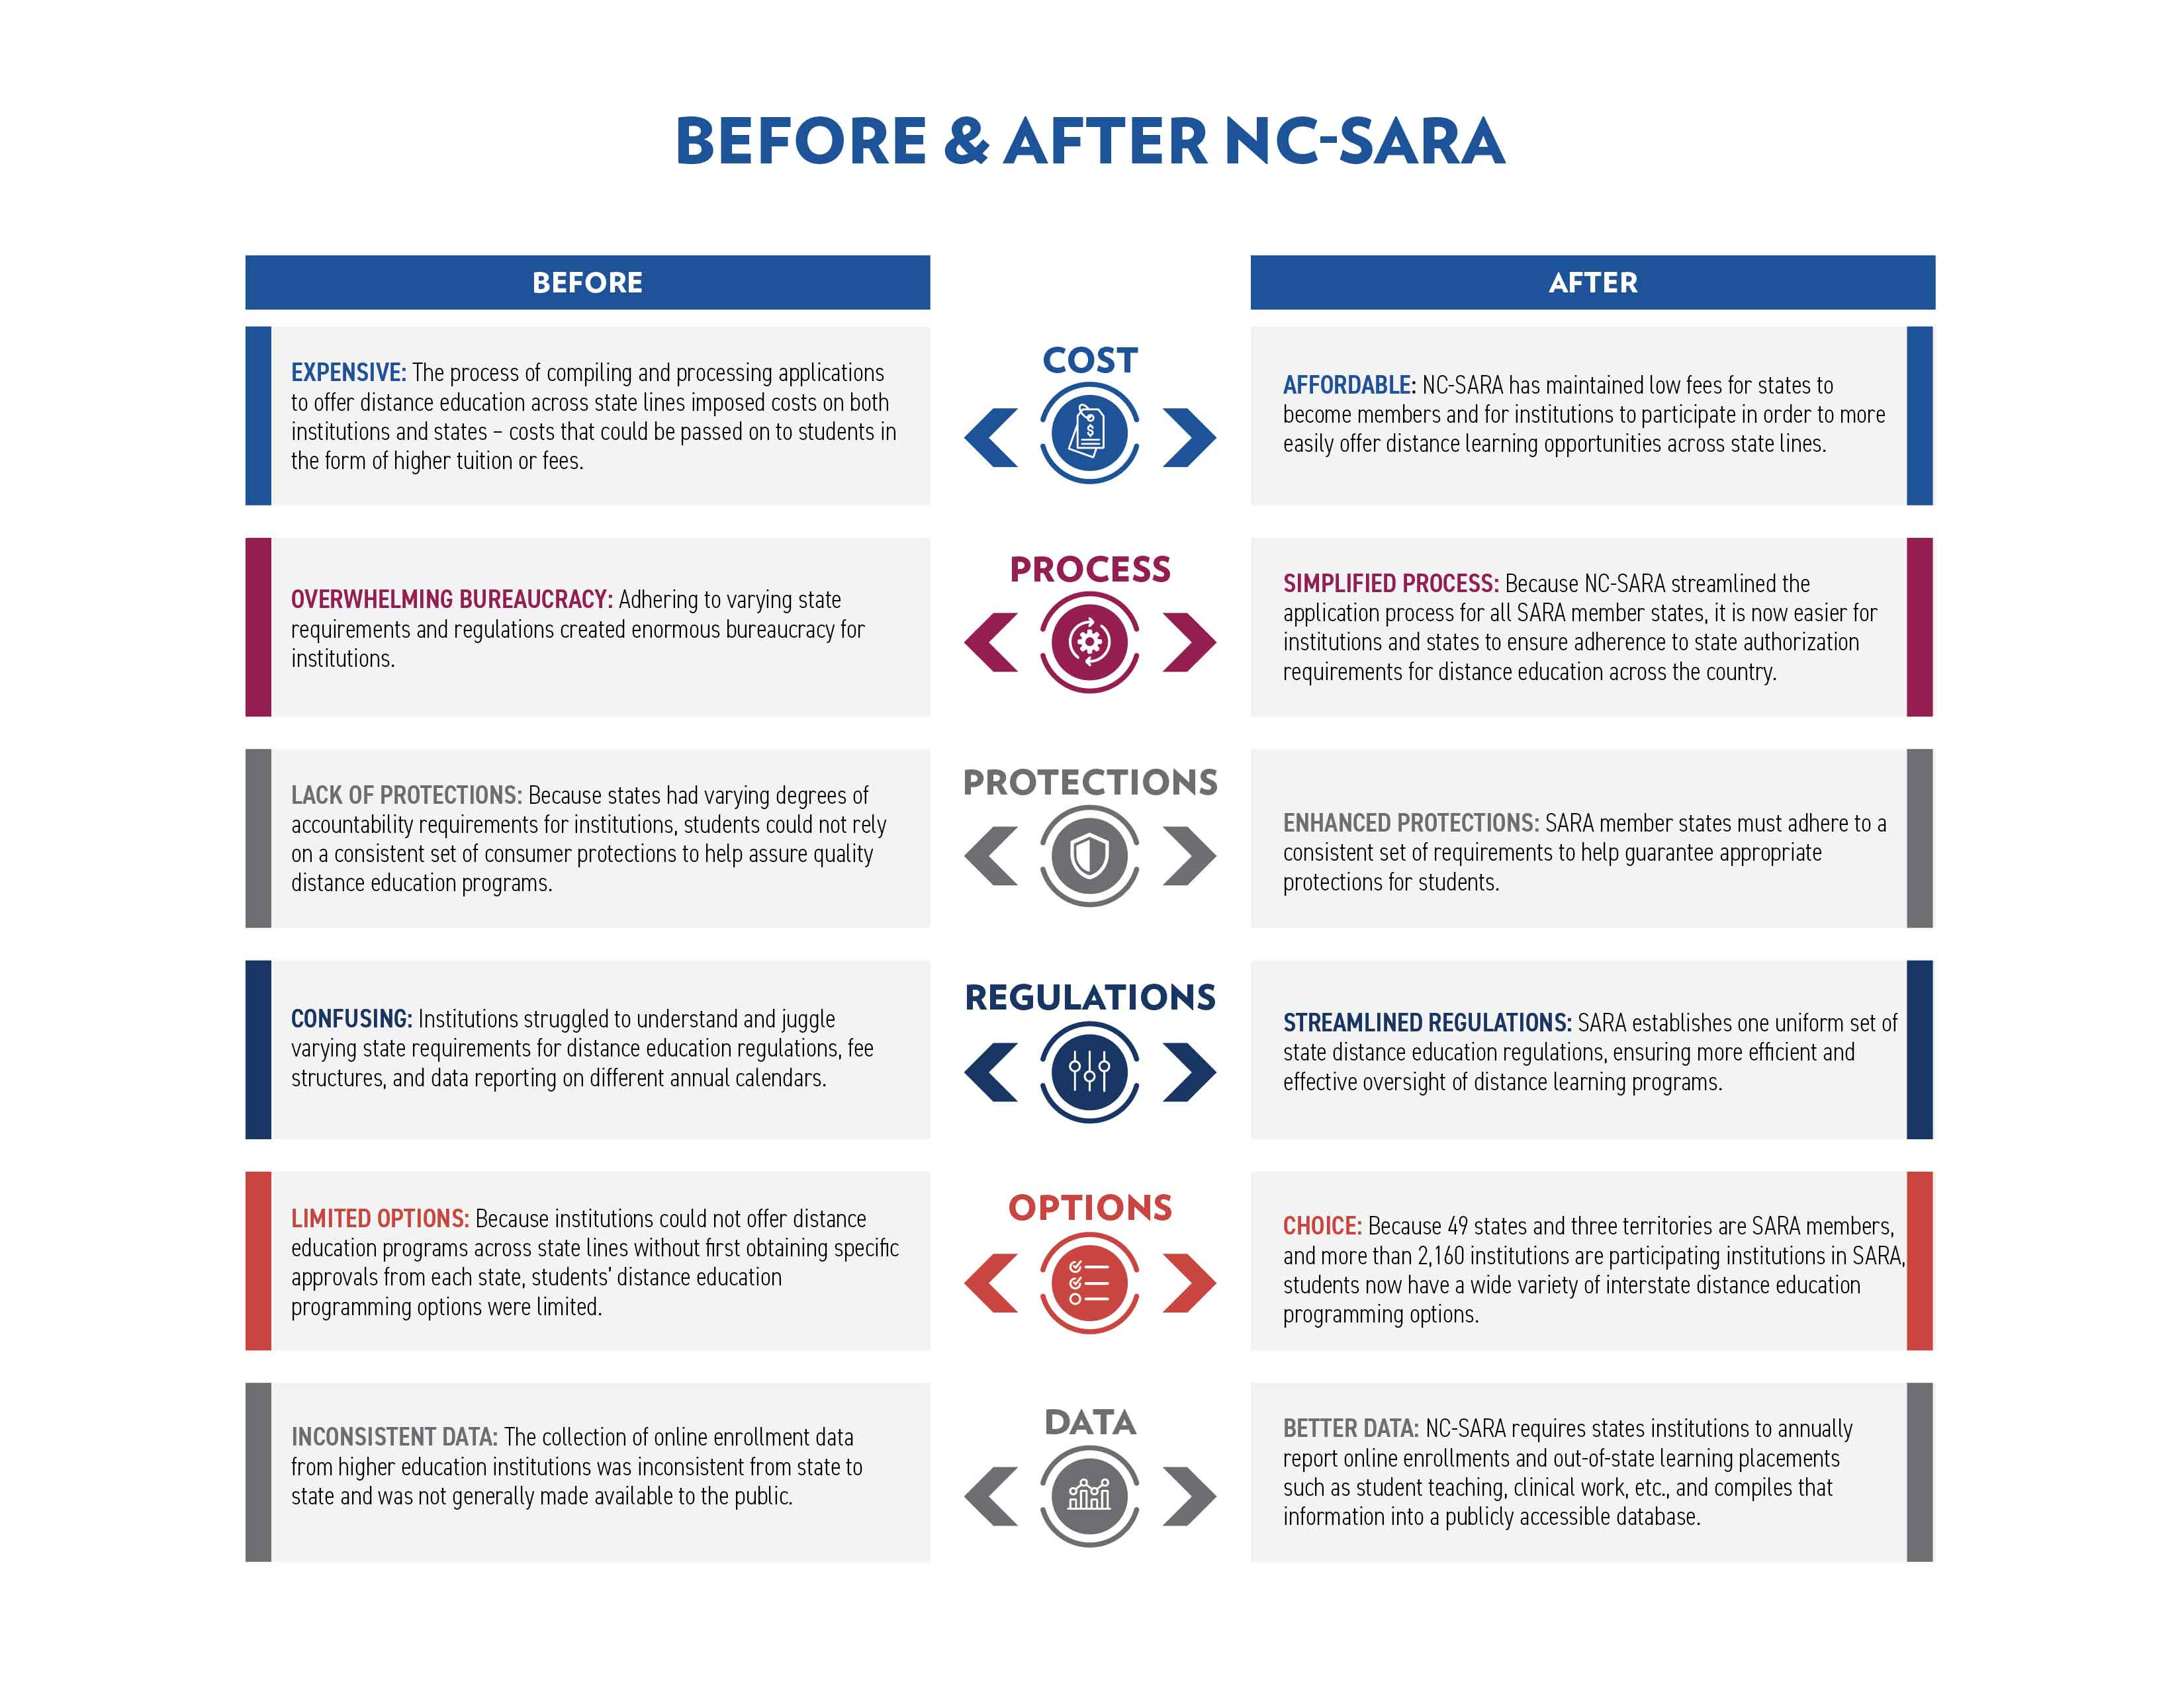

Slide 14
SARA LANDSCAPE
52 Member States and Territories
2100+ Institutions
51% - Public
6% - Private for-profit
43% - Private non-profit
Region
28% - MHEC
14% - NEBHE
45% - SREB
13% - WICHE
Notes:
Lori

Slide 15

Students Benefit from SARA
Expands access to educational offerings.
Better resolution of complaints from students in SARA states.
Reduces institutional cost that is in one way or another passed along to students.

Slide 16
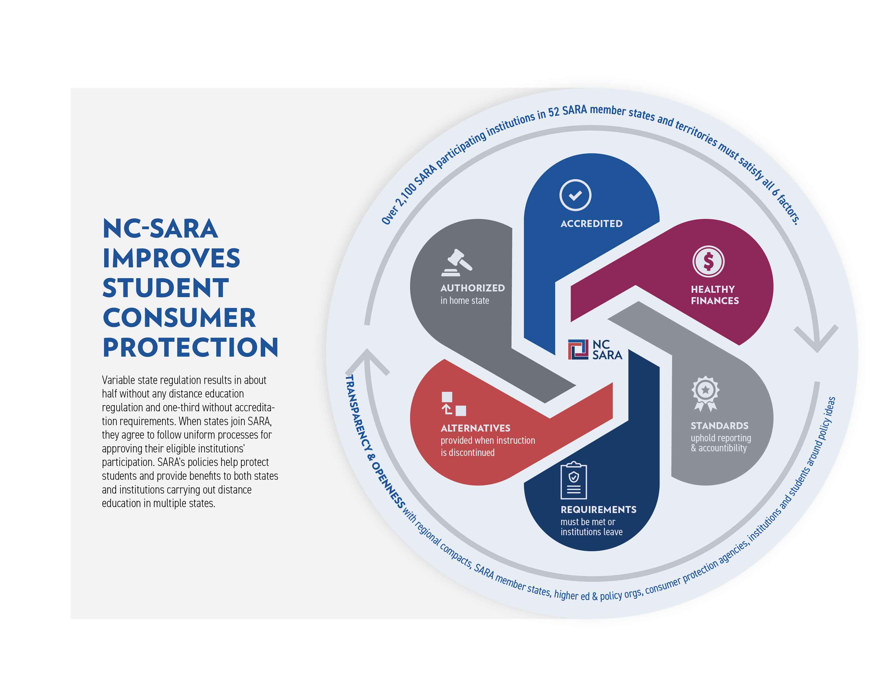

Slide 17
SARA Fees & Cost Savings

Slide 18

What does State Authorization Cost?
(Without SARA)
  The fee for authorization varies widely among agencies, from $0 to $10,000+ per agency.
  Some agencies require a fee for a waiver/exemption.
  There can be other fees involved:
    Site visit
    Tuition recovery fund
  Some agencies require a fee for renewal.

Slide 19

Fees for SARA
Annual Fees*:
$2,000/year for institutions with fewer than 2,500 FTE students
$4,000/year for institutions between 2,500-9,999 FTE students
$6,000/year for institutions with 10,000 or more FTE students
To cover the in-state costs of administering SARA, many SARA states charge their participating institutions a separate, state fee. Chart of established state fees available here: https://nc-sara.org/state-fees-state-institutions
*Have not increased!

Slide 20

Participation in SARA provides a tool for institutions to more easily engage in:
Distance education
Advertising
Recruiting
Field trips
Supervised field experiences
And more…
SARA provides reciprocity for many out-of-state activities, but not all.

Slide 21

Institutions Benefit from SARA
Enables a broader market.
Reduces number of applications to other states.
Reduces number of other-state regulations to monitor.
Reduces costs.

Slide 22
Cost Savings Project
Overarching goal: to gain insight to the cost savings associated with SARA participation.
Nearly two SARA hundred institutions responded to a survey and were representative of SARA membership by region, size, and institution type.
Estimated costs for institutions were calculated for both SARA membership and non-SARA membership based on:
  Location, size, out-of-state enrollments, and number/type of programs offered.
Preliminary results:
  Costs can potentially be 30 times greater for Non-SARA institutions for initial authorization
  12 times as much annually (at renewal)
  For a typical SARA participating institution this translates to a savings of approximately $188,000 initially, and $64,000 in subsequent years.
Cost Savings Project Report – Early 2021

Slide 23
An Institutional Perspective

Slide 24
Evolution of State Authorization
Federal Regulation – 2010
  Brought greater attention to SA
  Institutions began deep dive of program offerings and physical presence
  For many the need to begin intensive applications/work
  Federal regulations postponed, but states had become aware and enforced regulations already on the books
New regulations meant new work and departmental positions
  Who should complete this work? How much does it entail? What are the qualifications?
NEW POSITIONS CREATED and/or evolved job roles!

Slide 25
General State Authorization Tasks
Research institutional offerings and placement programs
Analyzes current regulations, new regulations, or changes in existing regulations
Complete applications (initial, renewals, exemptions, data)
  Project planning
Site visit preparation and execution
Work with other university departments to obtain engagement, data, and support for compliance activities
Track and report curriculum changes, new programs, or other changes to approval agencies
Institutional liaison between state entities and institution
NC-SARA Coordinator

Slide 26
State Authorization Knowledge
Understanding of all university governance, faculty model, curriculum structure, and academic service/FA
Know where students are and where they will be, at all times in their program! (NC-SARA, Federal Regulations)
Know who owns the data and policies for each area
  Student notification/complaints/disclosures; Institutional Catalog

Slide 27
Prior NC-SARA
Tracking for compliance
  Where are students located
    Physical
    Online
Where are students conducting field experiences?
Professional licensure
Budgets of up to half a million dollars to maintain state approvals

Slide 28
Tracking for Ongoing Authorization / Compliance
Enrollment
Completers
Retention / Graduation / Employment Rates
Financial Aid
Financial Statements
Recruiting Agent Licenses
Program Modifications
Faculty
Student Complaints
Advertisement / Partnerships
Secretary of State
Professional licensure
Surety Bonds

Slide 29
What next?
The work continues
  Disclosures
    General
    Individual
NC-SARA may have opened the doors to greater institutional reach; however, the work and role of State Authorization professionals continues to grow and are more relevant and valuable

Slide 30
Discussion: Q & A

Slide 31
For questions please email:
Info@nc-sara.org
NC-SARA Website: www.nc-sara.org
Twitter: @NCSARA_News
Thank You!

