Slide 1


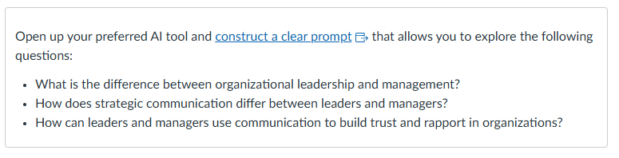

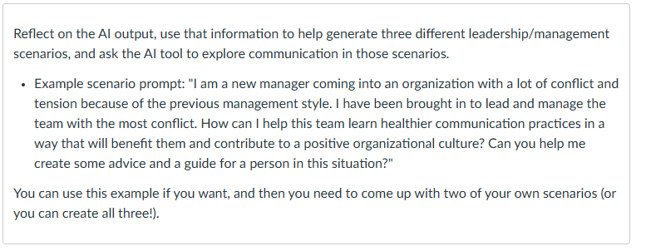



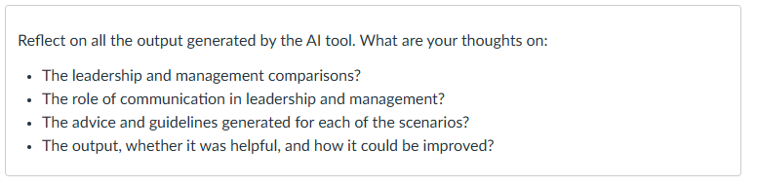

Prompt, Generate, Reflect: Using AI in Online Discussions to Teach Ethical Writing Practices
Mark Farris, M.A., and Tricia Burke, Ph.D.
Texas State University
Objectives
Explore
1. Describe how AI can be used as a tool for student reflection in asynchronous discussion assignments.
2. Analyze a sample AI-integrated discussion assignment for ethical considerations and engagement design.
3. Draft an AI-enhanced discussion prompt for a course you teach, including guidance for student reflection.
Explore
Encourage students to explore the generative AI tools available through the University, and to experiment with them in a comfortable setting.
Introduction
Apply
Apply
Students were provided an opportunity to explore, apply, and reflect on the use of AI tools in graduate-level courses.
Guide their exploration with content-specific prompts and use cases.
Explore
Reflect
Have the students reflect on what the generative AI provided. Have the students compare their work to what the generative AI created.
Reflect
Apply
How will you Use AI in Your Discussions?
How can you implement generative AI into one of your online discussions?
Reflect
AI literacy is an important new skill.
-José Antonio Bowen

