Slide 1
Beyond Understanding: Working with Faculty to Compose Exemplary Objectives
Matthew Acevedo, M.A. Florida International University, Miami, FL

Slide 2
Learning Objectives
Upon completion of this session, you’ll be able to:
Describe the importance of learning objectives.
Collaborate with subject matter experts and faculty members to create learning objectives that are appropriate for online and hybrid environments in higher education.
Identify broad instructional goals for higher education courses and translate them to course-level learning objectives.
Conduct subordinate skills analyses on the course-level objectives to determine module- or unit-level objectives.
Translate existing vague, immeasurable, or “fuzzy” learning objectives to meaningful, measurable objectives.

Slide 3
Why are we here?

Slide 4
2.1 The course learning objectives describe outcomes that are measurable.
2.2 The module/unit learning objectives describe outcomes that are measurable and consistent with the course-level objectives.
2.3 All learning objectives are stated clearly and written from the students’ perspective.

Slide 5
Forbidden Terms
Understand
Learn
Know
Become acquainted with
Realize
Recognize
Internalize
Appreciate
Believe

Slide 6
Working with faculty to compose learning objectives can often be...

Slide 7
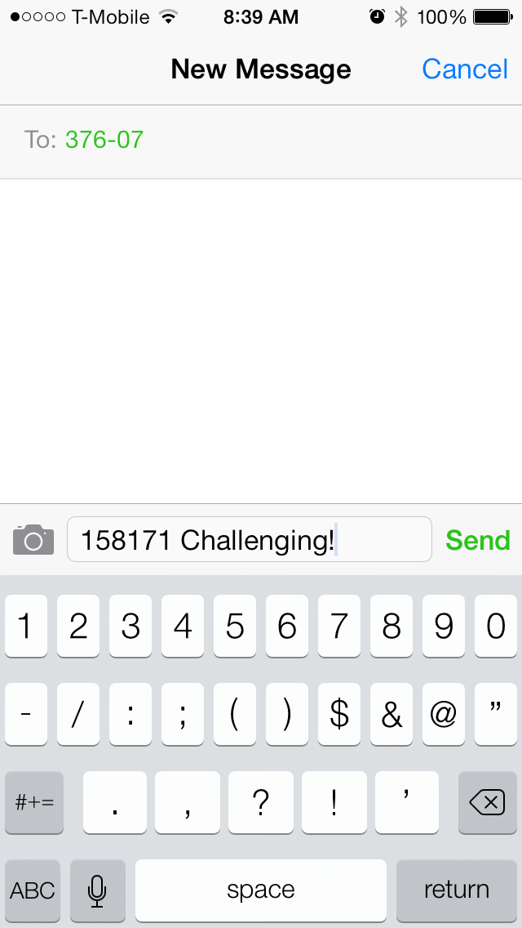
Working with faculty to compose learning objectives can often be _________ . Text your answer to 37607 Start your message with 158171

Slide 8
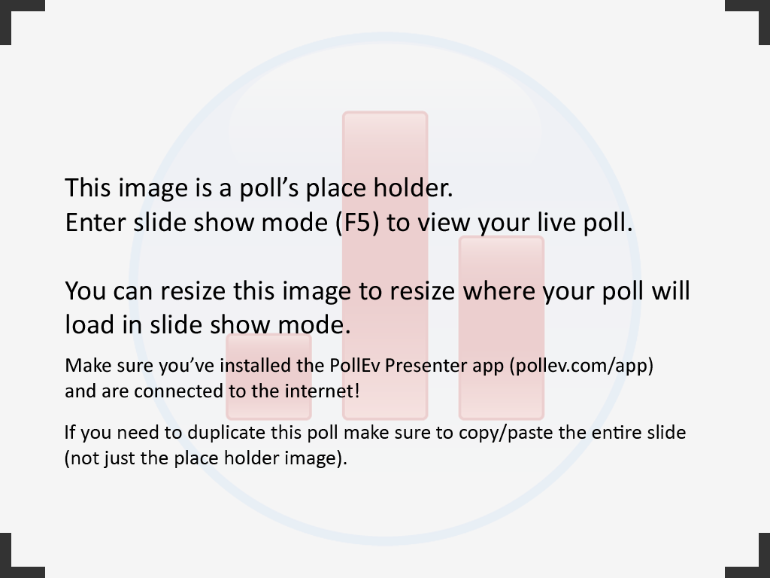
Notes:
Poll Title: Working with faculty to compose learning objectives can often be... http://www.polleverywhere.com/free_text_polls/pwFGZ0ijeMrbUZt

Slide 9
Why are objectives important?

Slide 10
Why are objectives important?
^
good

Slide 11
The Importance of Being Objective
Objectives should give the learner clear expectations of the course/unit.
Objectives should inform the selection of instructional materials and the instructional strategy.
Objectives should mirror the assessment strategy.

Slide 12
What happens when we ask our faculty members, “What are your course objectives?”
The following examples come
from real university courses.

Slide 13
What are your course objectives?
After successfully completing this course, the student will:
Become aware of the operations functions in all businesses.
Become familiar with decision-making tools and methods and apply them appropriately to problems and simulation situations.
Solve real-life problems related to operations management.

Slide 14
What are your course objectives?
After successfully completing this course, the student will:
Have an understanding of alternative methods used by healers and mediums globally.
Recognize patterns of evolutionary change from rituals and practices that may reshape the future while preserving the traditions of aesthetics and cultural values of the past.
Be able to demonstrate knowledge of the cultural and cross-cultural dynamics involved in these alternative methods of healing.
Gain an appreciation for the diversity of life on Earth as well as an acceptance of various ways used to heal the maladies of the body from a global viewpoint.
Complete a research assignment (a PPT, media or paper presentation) that involves active contact with global forms of healing as a methodology.

Slide 15
What are your course objectives?
After successfully completing this course, the student will:
Master Working with Files
Master Using Excel to Manage Data and Working with Formulas and Functions
Master Developing a Professional-Looking Worksheet and Working with Charts and Graphics
Master Working with Excel Lists
Master Working with Multiple Worksheets and Workbooks
Master Working with Excel's Editing and Web Tools
Master Developing an Excel Application
Master Introduction to Microsoft Access 2010 and Creating and Maintaining a Database
Master Querying a Database and Creating Forms and Reports
Master Enhancing a Table's Design, and Creating Advanced Queries
Master Creating Custom Forms
Master Creating Custom Reports

Slide 16
What are your course objectives?
This course offers students techniques and skills to enhance their management of employment related disputes. It is designed to teach students the basic theory and practice regarding labor relations, including union organizing, union, avoidance, collective bargaining and grievance resolution. Students will learn methods to productively manage relationships and disputes with employees, within both union and non-union environments. An emphasis will be placed on various methods of conflict resolution, with specific student practical experience and involvement in grievance resolution, collective bargaining, and mediation of employer/employee and employer/union disputes, as well as an overview of the arbitration process. The course will explain methods for identifying issues of dispute, strategies for addressing and resolving those disputes through appropriate procedures, and creating, maintaining and utilizing various dispute resolution methods within the employment relationship. Students will investigate the theoretical and practical aspects of employee reasons for union interest and selection, union representation and employer obligations, collective bargaining, employment related conflicts, resolution of employee grievances and the use of both mediation and arbitration for conflict resolution in various labor and employment contexts. Emphasis will be placed on practical exercises regarding union organizing and elections; union conflicts with management, and the collective bargaining process and procedure; processing, investigating and resolving individual employee and union grievances; informal grievance resolution procedures; mediation in collective bargaining, agency and litigation settings; as well as an overview of arbitration under collective bargaining agreements, company policy and individual employment contracts. Through these practical exercises, students will develop an understanding and ability to perform employee dispute assessment, to determine the appropriate use of specific conflict assessment, communication, and resolution options within an organization; and to identify the appropriate information gathering, assessment, strategies, tactics and goals for use with various employment based conflict resolution methods.

Slide 17


Slide 18
What makes a good learning objective?
A sound learning objective is an intent communicated by a statement describing a proposed change in a learner leading to a pattern of behavior that is observable and measureable.

Slide 19
Or, in English…
What can a learner do after his or her time with you that he or she couldn’t do before?

Slide 20
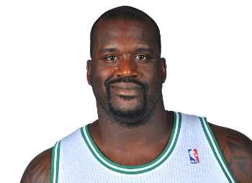
In Other Words
There’s a big difference between understanding how to shoot a free throw and actually shooting free throws.

Slide 21
Bloom’s Taxonomy (of course)
Judge
Evaluation
Synthesis
Analysis
Knowledge
Application
Comprehension
Construct
Analyze
Calculate
Classify
Explain
Identify
Define

Slide 22
Bloom’s Taxonomy is not a checklist.

Slide 23
Terminal and Enabling Objectives
Terminal objective: What students should be able to do when the course is done.
Enabling objective: What students need to be able to do during the course to achieve the terminal objectives (subordinate to the terminal objective).

Slide 24
Let’s speak QM
Terminal objective = course objective
(QM Standard 2.1)
Enabling objective = module/unit objective
(QM Standard 2.2)

Slide 25
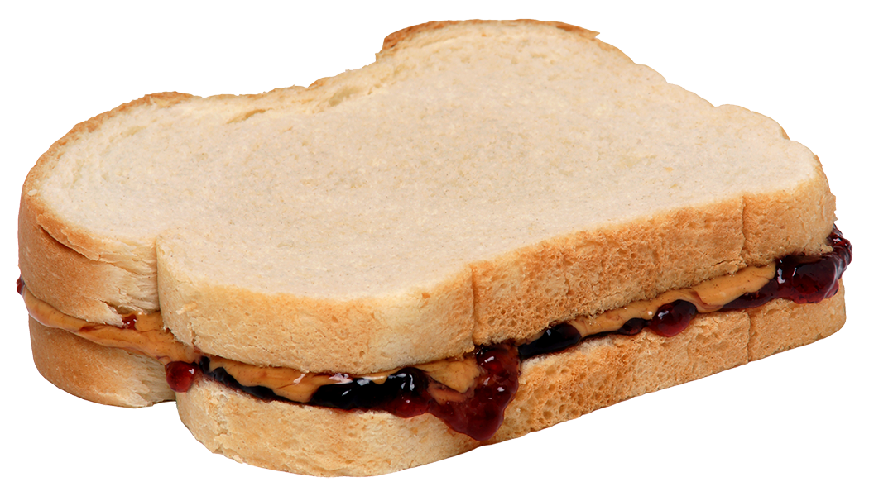

Slide 26

Foundations of PB&J
Upon completion of this course, students will be able to:
Understand the basics of peanut butter and jelly sandwiches.

Slide 27
Foundations of PB&J
Upon completion of this course, students will be able to:
Select appropriate ingredients for a peanut butter and jelly sandwich.
Assemble a peanut butter and jelly sandwich.
Consume a peanut butter and jelly sandwich.
Properly dispose of sandwich remains.

Slide 28
Terminal objective: Select appropriate ingredients for a peanut butter and jelly sandwich.
Course-level objectives
Enabling objective: Differentiate between different types of breads.
Enabling objective: Identify types of jellies and jams, including flavors appropriate for PB&J sandwiches.
Enabling objective: List the features of the different varieties of peanut butter.
Enabling objective: Describe accommodations for those with dietary preferences and/or restrictions.
Enabling objective: Explain the purpose of gluten-free bread.
Enabling objective: Explain the purpose of low-sugar jelly.
Module/unit-level objectives
Entry skill: Define bread
Entry skill: Define jelly and jam
Entry skill: Define peanut butter
Pre-requisite skills

Slide 29
What does this look like in real life?

Slide 30
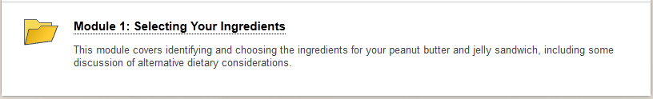
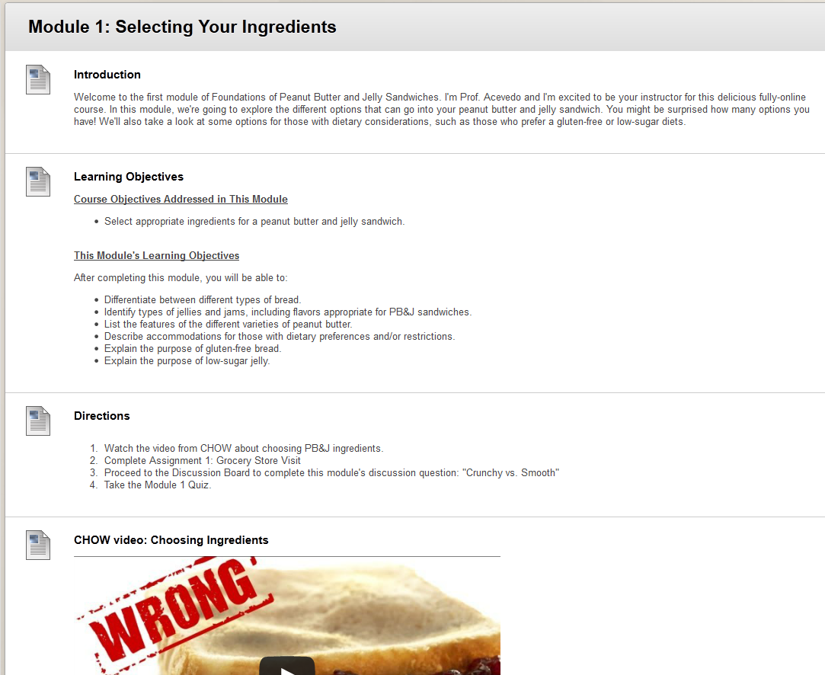

Slide 31
How do we get this from faculty members?

Slide 32
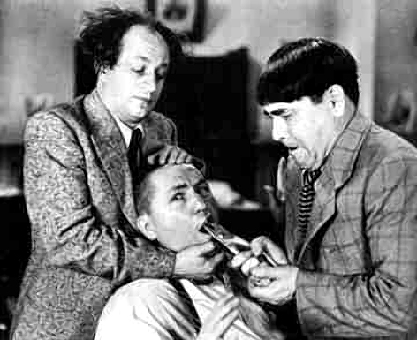

Slide 33
Common Scenarios

Slide 34
Scenario 1
Faculty member already has well-written, measureable objectives.

Slide 35

Scenario 1

Slide 36
Scenario 2
Faculty member needs help
writing new course objectives.

Slide 37
Scenario 2
Ask:
“What can students do, after taking your course, that they couldn’t do before?”
This gives you your terminal (course-level) objectives.

Slide 38
Scenario 3
Faculty member has course objectives, but doesn’t have module/unit objectives.

Slide 39
Scenario 3
Ask:
“What must students be able to do before accomplishing the course objectives?”
This gives you your subordinate (module-level) objectives.
Be sure to differentiate between subordinate objectives and entry-skills.

Slide 40
Scenario 4
Faculty member has some or all objectives that are immeasurable, vague, or “fuzzy.”

Slide 41
Scenario 4
Ask:
“How are you planning on assessing this objective?”
Multiple choice: define, identify
Fill-in-the-blank: recall, name, recite
Essay: [prompt] = objectives
Project: [final product] = objectives

Slide 42
Scenario 5
Nothing else has worked.
You’ve reached a brick wall.

Slide 43
Scenario 5
Ask:
“Your student is going to work at an entry-level job in the area of this course. What is he/she going to do at work? What earns him/her a paycheck?”
This will hopefully, at the least, giving you a jumping-off point.

Slide 44
Getting Your Hands Dirty
What type of scenario do you have?
What’s your plan of action?
You have three minutes.

Slide 45
Scenario 1: Faculty member already has well-written, measureable objectives.
Scenario 2: Faculty member needs help writing new course objectives.
Scenario 3: Faculty member has course objectives, but doesn’t have module/unit objectives.
Scenario 4: Faculty member has some or all objectives that are immeasurable, vague, or “fuzzy.”
Scenario 5: Nothing else has worked.

Slide 46
Situation A: Victimology
Situation B: Crisis Management
Situation C: Film Theory
Situation D: Psychology of Aging
Situation E: Freshman English
Situation F: Human Resource Management
Notes:
Situation A: Victimology - 4
Situation B: Crisis Management - 1
Situation C: Film Theory – 5
Situation D: Psychology of Aging - 4
Situation E: Freshman English – 2
Situation F: Human Resource Management - 3

Slide 47
Tough Scenarios

Slide 48
Foreign language?

Slide 49
Philosophy?

Slide 50
Summary
We learned…
What good learning objectives are and why they are important.
How to determine terminal learning objectives based on desired course outcomes.
How to analyze terminal objectives to determine subordinate objectives and entry skills.
Common scenarios when working with faculty, and a framework of strategies when encountering these scenarios.

Slide 51
Questions?

Slide 52


Thanks!
: mmaceve@fiu.edu
: @mattacevedo

