Slide 1




Notes:
Hello. I’m Miran Kang, Director of Instructional Design and Support Services at the Global Campus.
In this presentation, I will talk about objectives, objectives, objectives: What is objective, why it’s important, and how to write good objectives.

Slide 2
Learning Objectives
Attendees will be able to use the ideas and tools presented during the session to enhance the effectiveness of faculty training.
Attendees will be able to use the ideas and tools presented during the session to introduce the QM standards in a more meaningful way.
Attendees will be able to use the tools presented during the session to develop online courses that meet the QM standards.

Slide 3
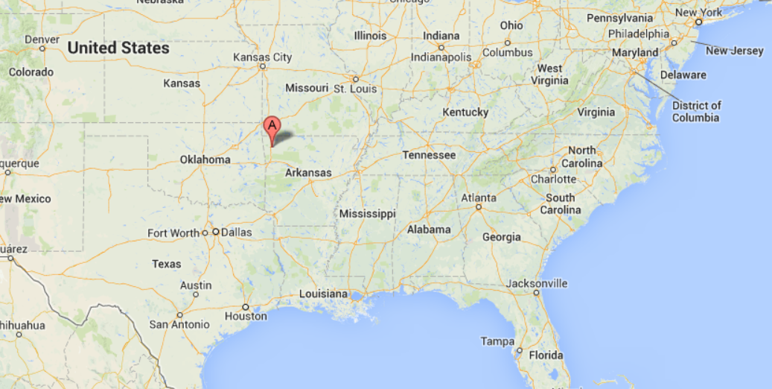
University of Arkansas - Fayetteville
Research 1 University
Over 25,000 students
Over 6,000 online students
Notes:
Hello. I’m Miran Kang, Director of Instructional Design and Support Services at the Global Campus.
In this presentation, I will talk about objectives, objectives, objectives: What is objective, why it’s important, and how to write good objectives.

Slide 4


Instructional Design & Support Services
1 Director
7 Instructional Designer
2 Academic Technologist

Slide 5
1
2
3
4
5
6
Fall 2011
Fall 2013
Spring 2012
Fall 2012
Spring 2013
Summer 2013

Slide 6
Fall 2011
Fall 2013
Spring 2012
Fall 2012
Spring 2013
Summer 2013
OCD #1
Orientation
10 week online course

Slide 7
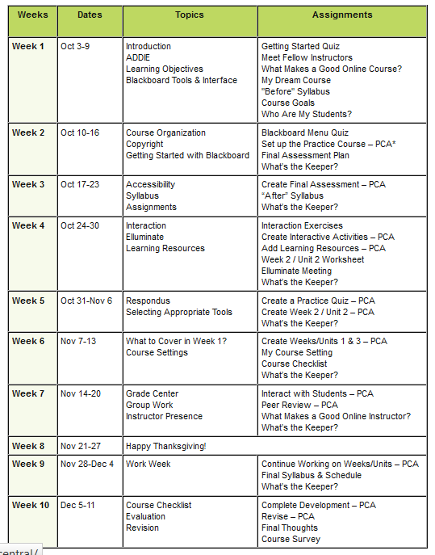

ADDIE
Objectives
Journal
Copyright
Accessibility
Blog
Learning objects
Respondus
Blackboard
Interaction
Collaborate

Slide 8
Fall 2011
Fall 2013
Spring 2012
Fall 2012
Spring 2013
Summer 2013
OCD #1
“
I’m not here to take
Intro to Educational Technology course!
”

Slide 9
Fall 2011
Fall 2013
Spring 2012
Fall 2012
Spring 2013
Summer 2013
OCD #2
4 weeks
Loose structure
No deadlines
Several didn’t finish in time

Slide 10
Fall 2011
Fall 2013
Spring 2012
Fall 2012
Spring 2013
Summer 2013
OCD #3
Divided into phases
    PHASE 1: Training, Analysis, & Design
    PHASE 2: Development
    PHASE 3: Evaluation, Improvement, & CELEBRATION

Slide 11
Fall 2011
Fall 2013
Spring 2012
Fall 2012
Spring 2013
Summer 2013
OCD #3
Divided into phases
Flexible with only bigger deadlines
Introduced QM standards to faculty
IDs became certified as QM Peer Reviewers
More focus on objectives and alignments

Slide 12
Fall 2011
Fall 2013
Spring 2012
Fall 2012
Spring 2013
Summer 2013
OCD #4
Orientation – course demo/showcase by faculty from previous training

Slide 13
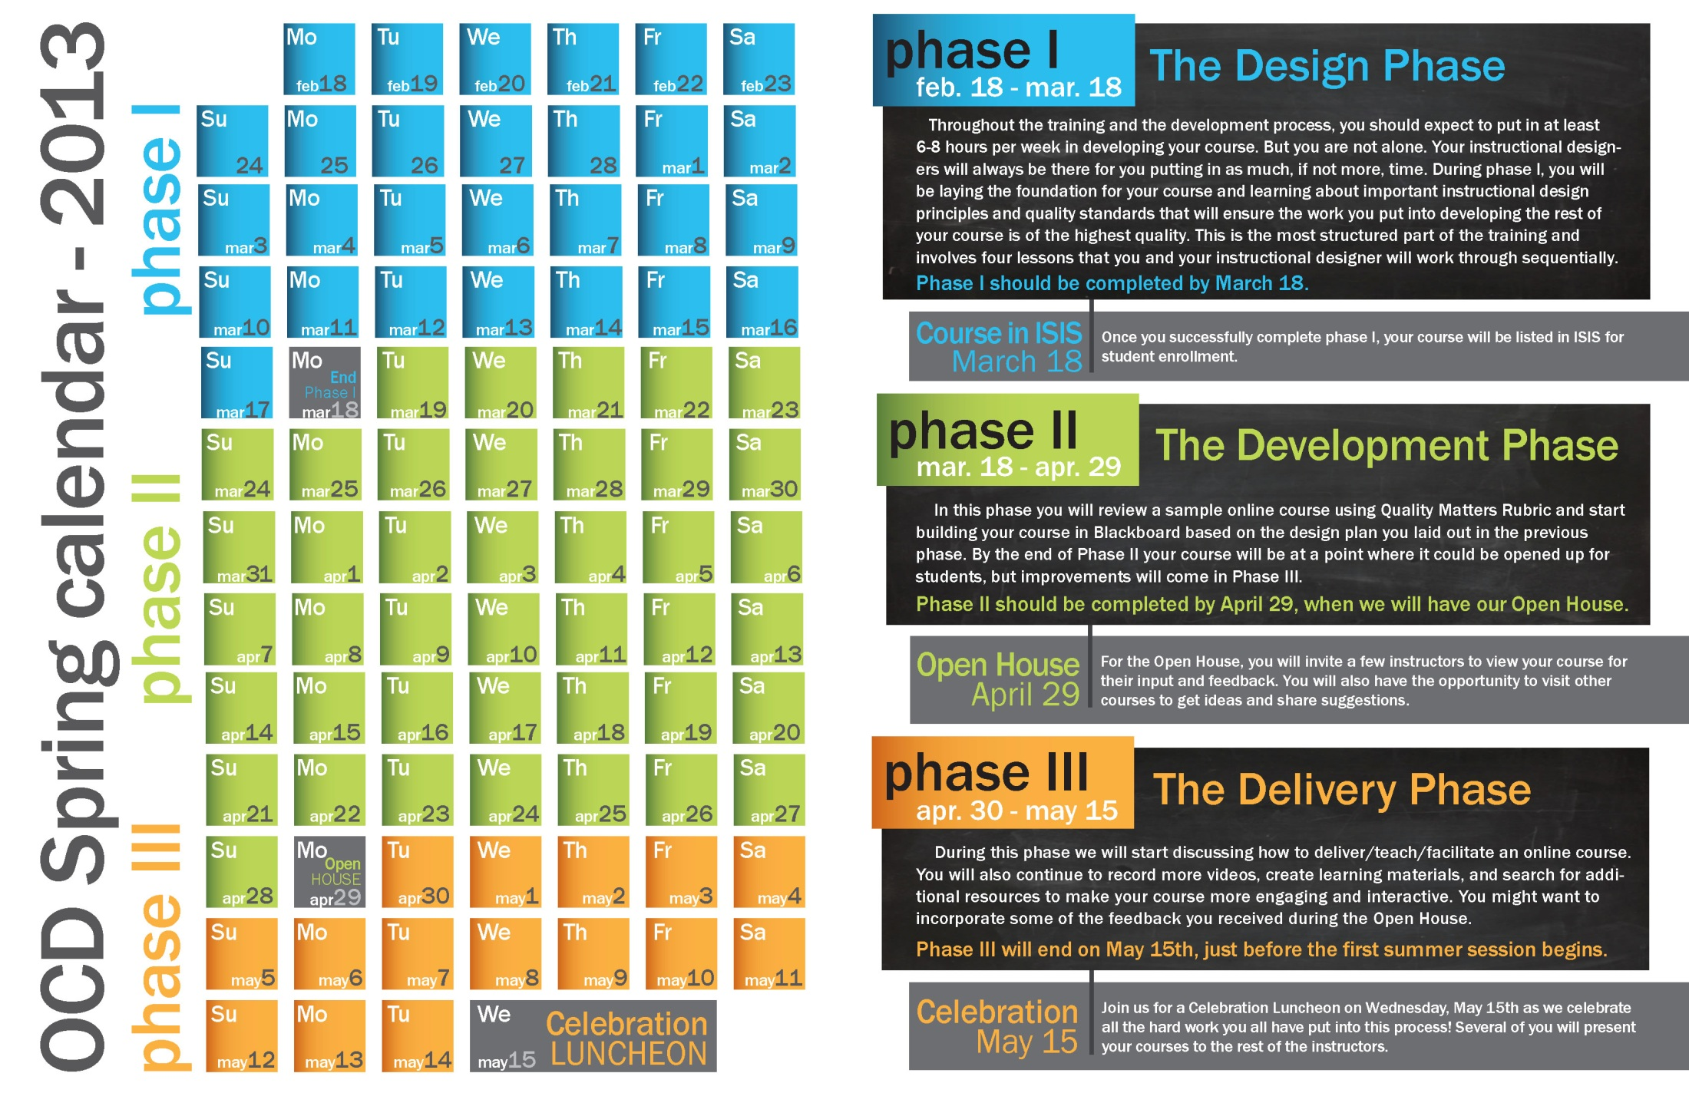
Fall 2011
Fall 2013
Spring 2012
Fall 2012
Spring 2013
Summer 2013
OCD #4
Orientation – course demo/showcase by faculty from previous training
Renamed 3 Phases

Slide 14
Fall 2011
Fall 2013
Spring 2012
Fall 2012
Spring 2013
Summer 2013
OCD #4
Orientation – course demo/showcase by faculty from previous training
Renamed 3 Phases
QM Scavenger Hunt course
http://tinyurl.com/qmhowto

Slide 15
Fall 2011
Fall 2013
Spring 2012
Fall 2012
Spring 2013
Summer 2013
OCD #4
Orientation – course demo/showcase by faculty from previous training
Renamed 3 Phases
QM Scavenger Hunt course
http://tinyurl.com/qmhowto
Applying QM Rubric Workshop

Slide 16
Fall 2011
Fall 2013
Spring 2012
Fall 2012
Spring 2013
Summer 2013
OCD #5
Moved the QM Scavenger Hunt to the first activity
DESIGN first!

Slide 17
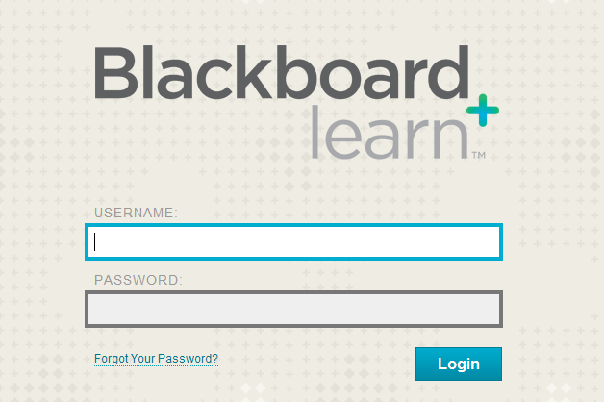
Lesson 1 | Objective 3a Objective 3b | Assessment 3a & 3b
Lesson 2 | Objective 3c Objective 4c | Assessment 3c Assessment 4c
Lesson 4 | Objective 2c Objective 2d | Assessment 1b, 2c, & 2d

Slide 18
Fall 2011
Fall 2013
Spring 2012
Fall 2012
Spring 2013
Summer 2013
OCD #5
Moved the QM Scavenger Hunt to the first activity
DESIGN first!
Clearer deliverables after each Phase
Administrative Support

Slide 19
Fall 2011
Fall 2013
Spring 2012
Fall 2012
Spring 2013
Summer 2013
OCD #5
Administrative Support
Progress Report I to Associate Deans & Department Chairs
Progress Report II to Associate Deans & Department Chairs

Slide 20
Fall 2011
Fall 2013
Spring 2012
Fall 2012
Spring 2013
Summer 2013
OCD #5
Administrative Support
Clearer deliverables after each Phase
Moved the QM Scavenger Hunt to the first activity

Slide 21
Fall 2011
Fall 2013
Spring 2012
Fall 2012
Spring 2013
Summer 2013
OCD #6
Moving away from “course” - More respectful and flexible model

Slide 22
FROM

Slide 23
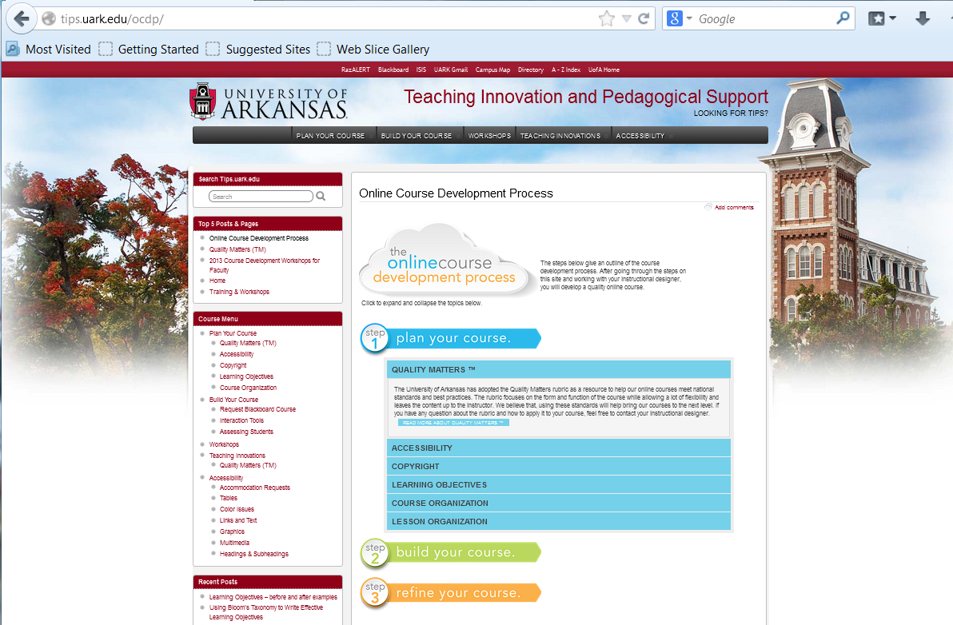



TO
OCD #6

Slide 24
Fall 2011
Fall 2013
Spring 2012
Fall 2012
Spring 2013
Summer 2013
OCD #6
Moving away from “course” - More respectful and flexible model
Hard deadline/milestone but flexible within each step

Slide 25


tips.uark.edu/ocdp

Slide 26
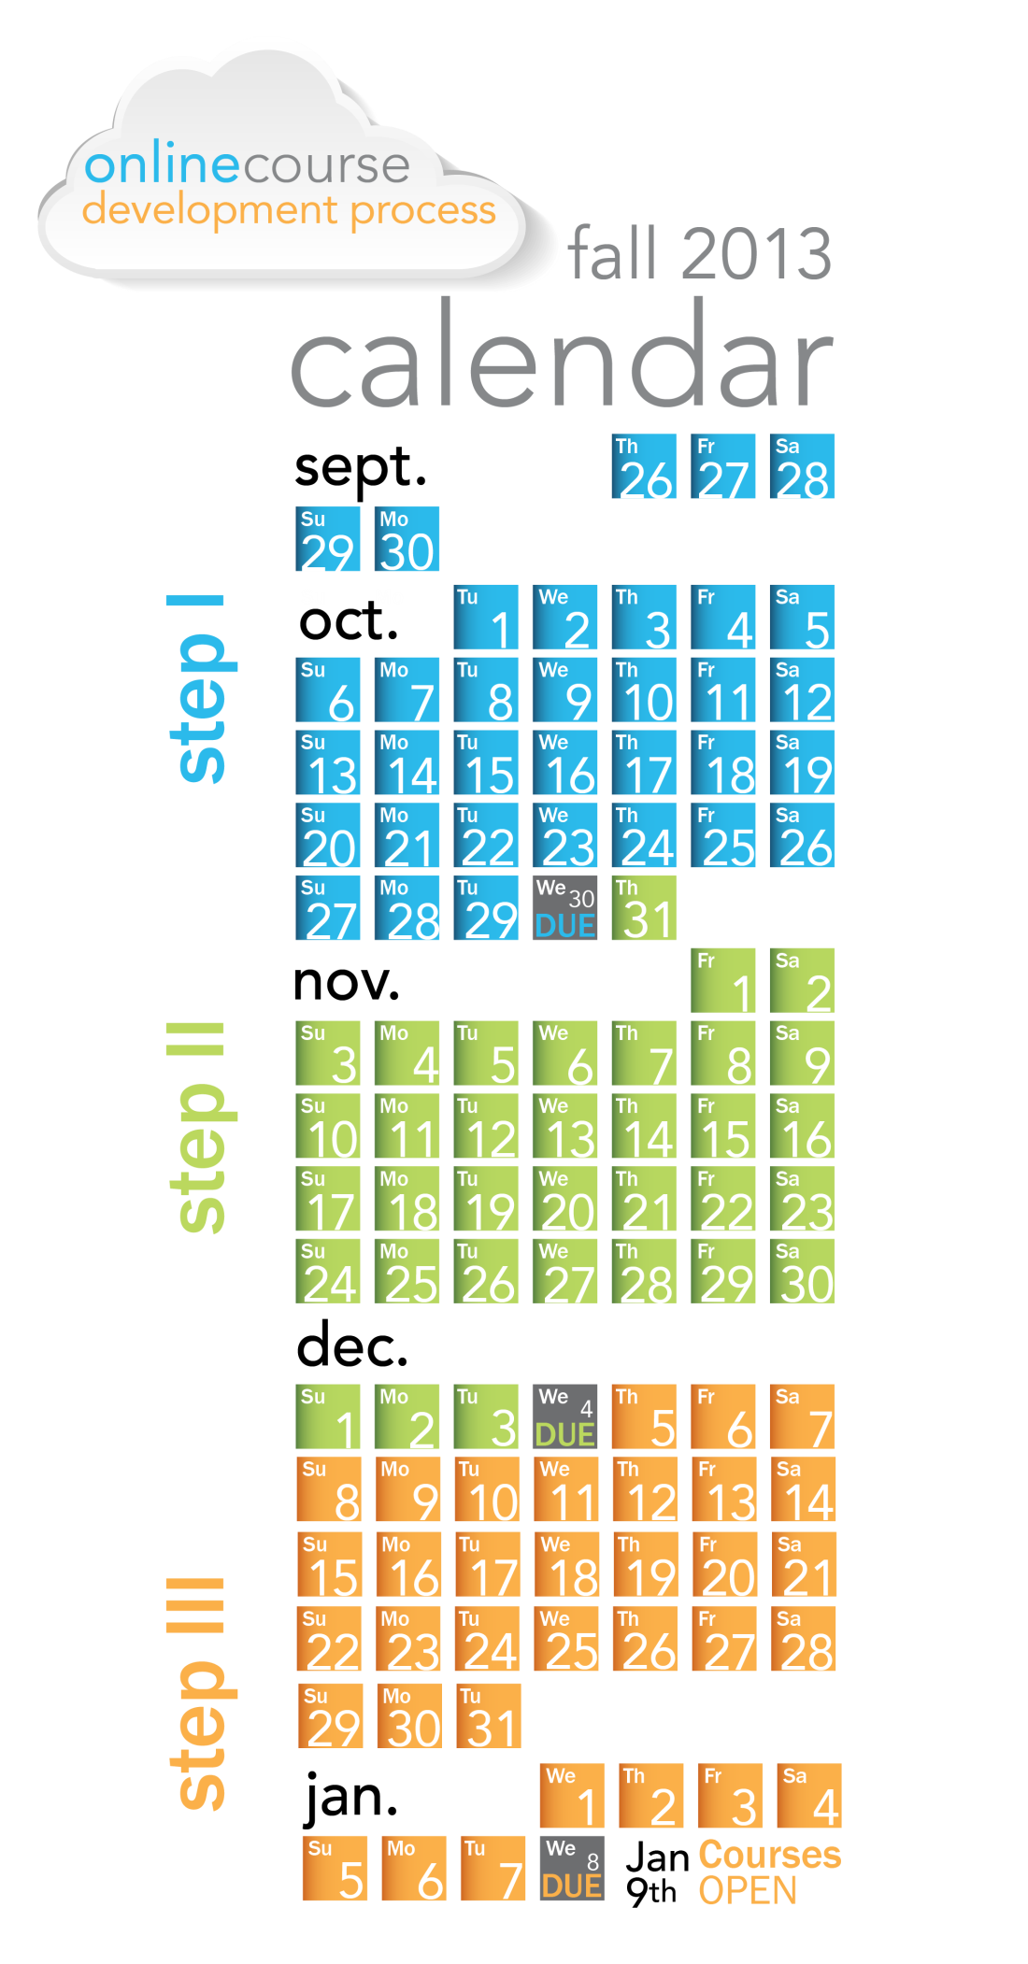

Slide 27
tips.uark.edu/ocdp

Slide 29
tips.uark.edu/ocdp

Slide 31
Fall 2011
Fall 2013
Spring 2012
Fall 2012
Spring 2013
Summer 2013
OCD #6
Moving away from “course” - More respectful and flexible model
Hard deadline/milestone but flexible within each step
Optional workshops/trainings

